Slide 1
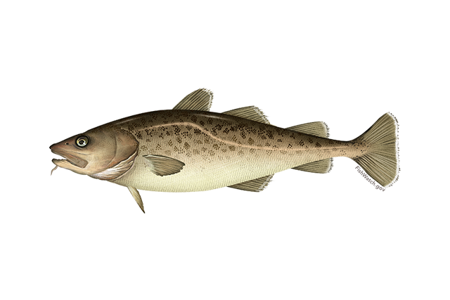


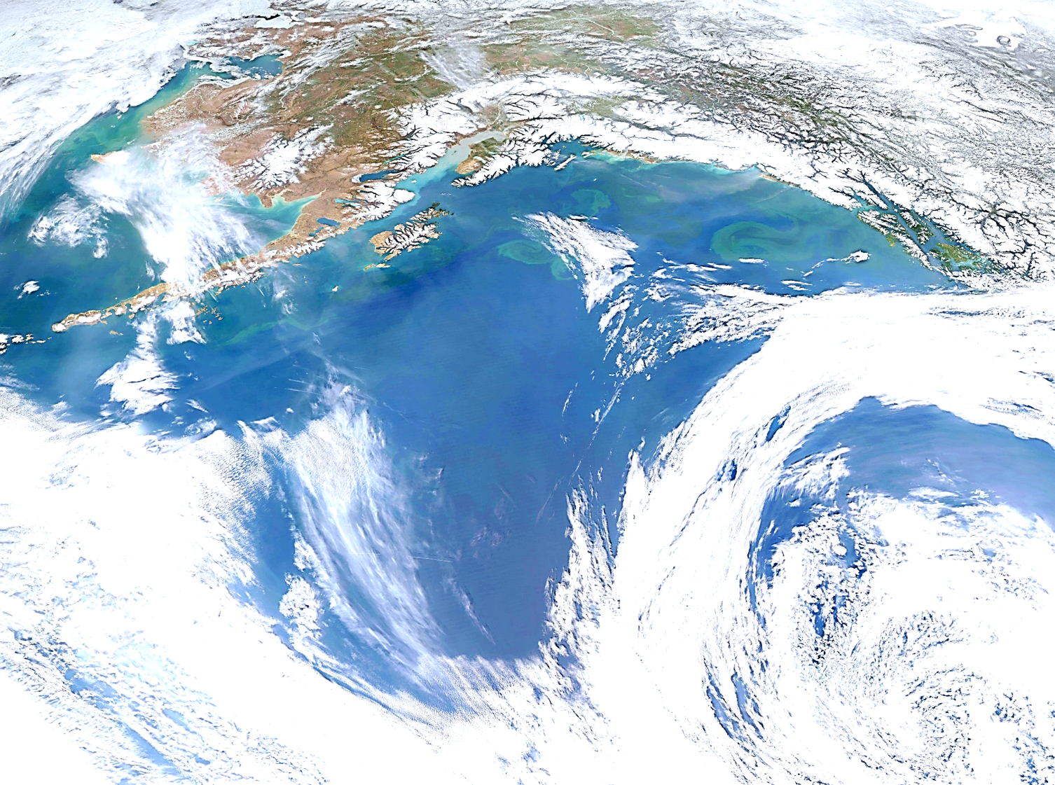
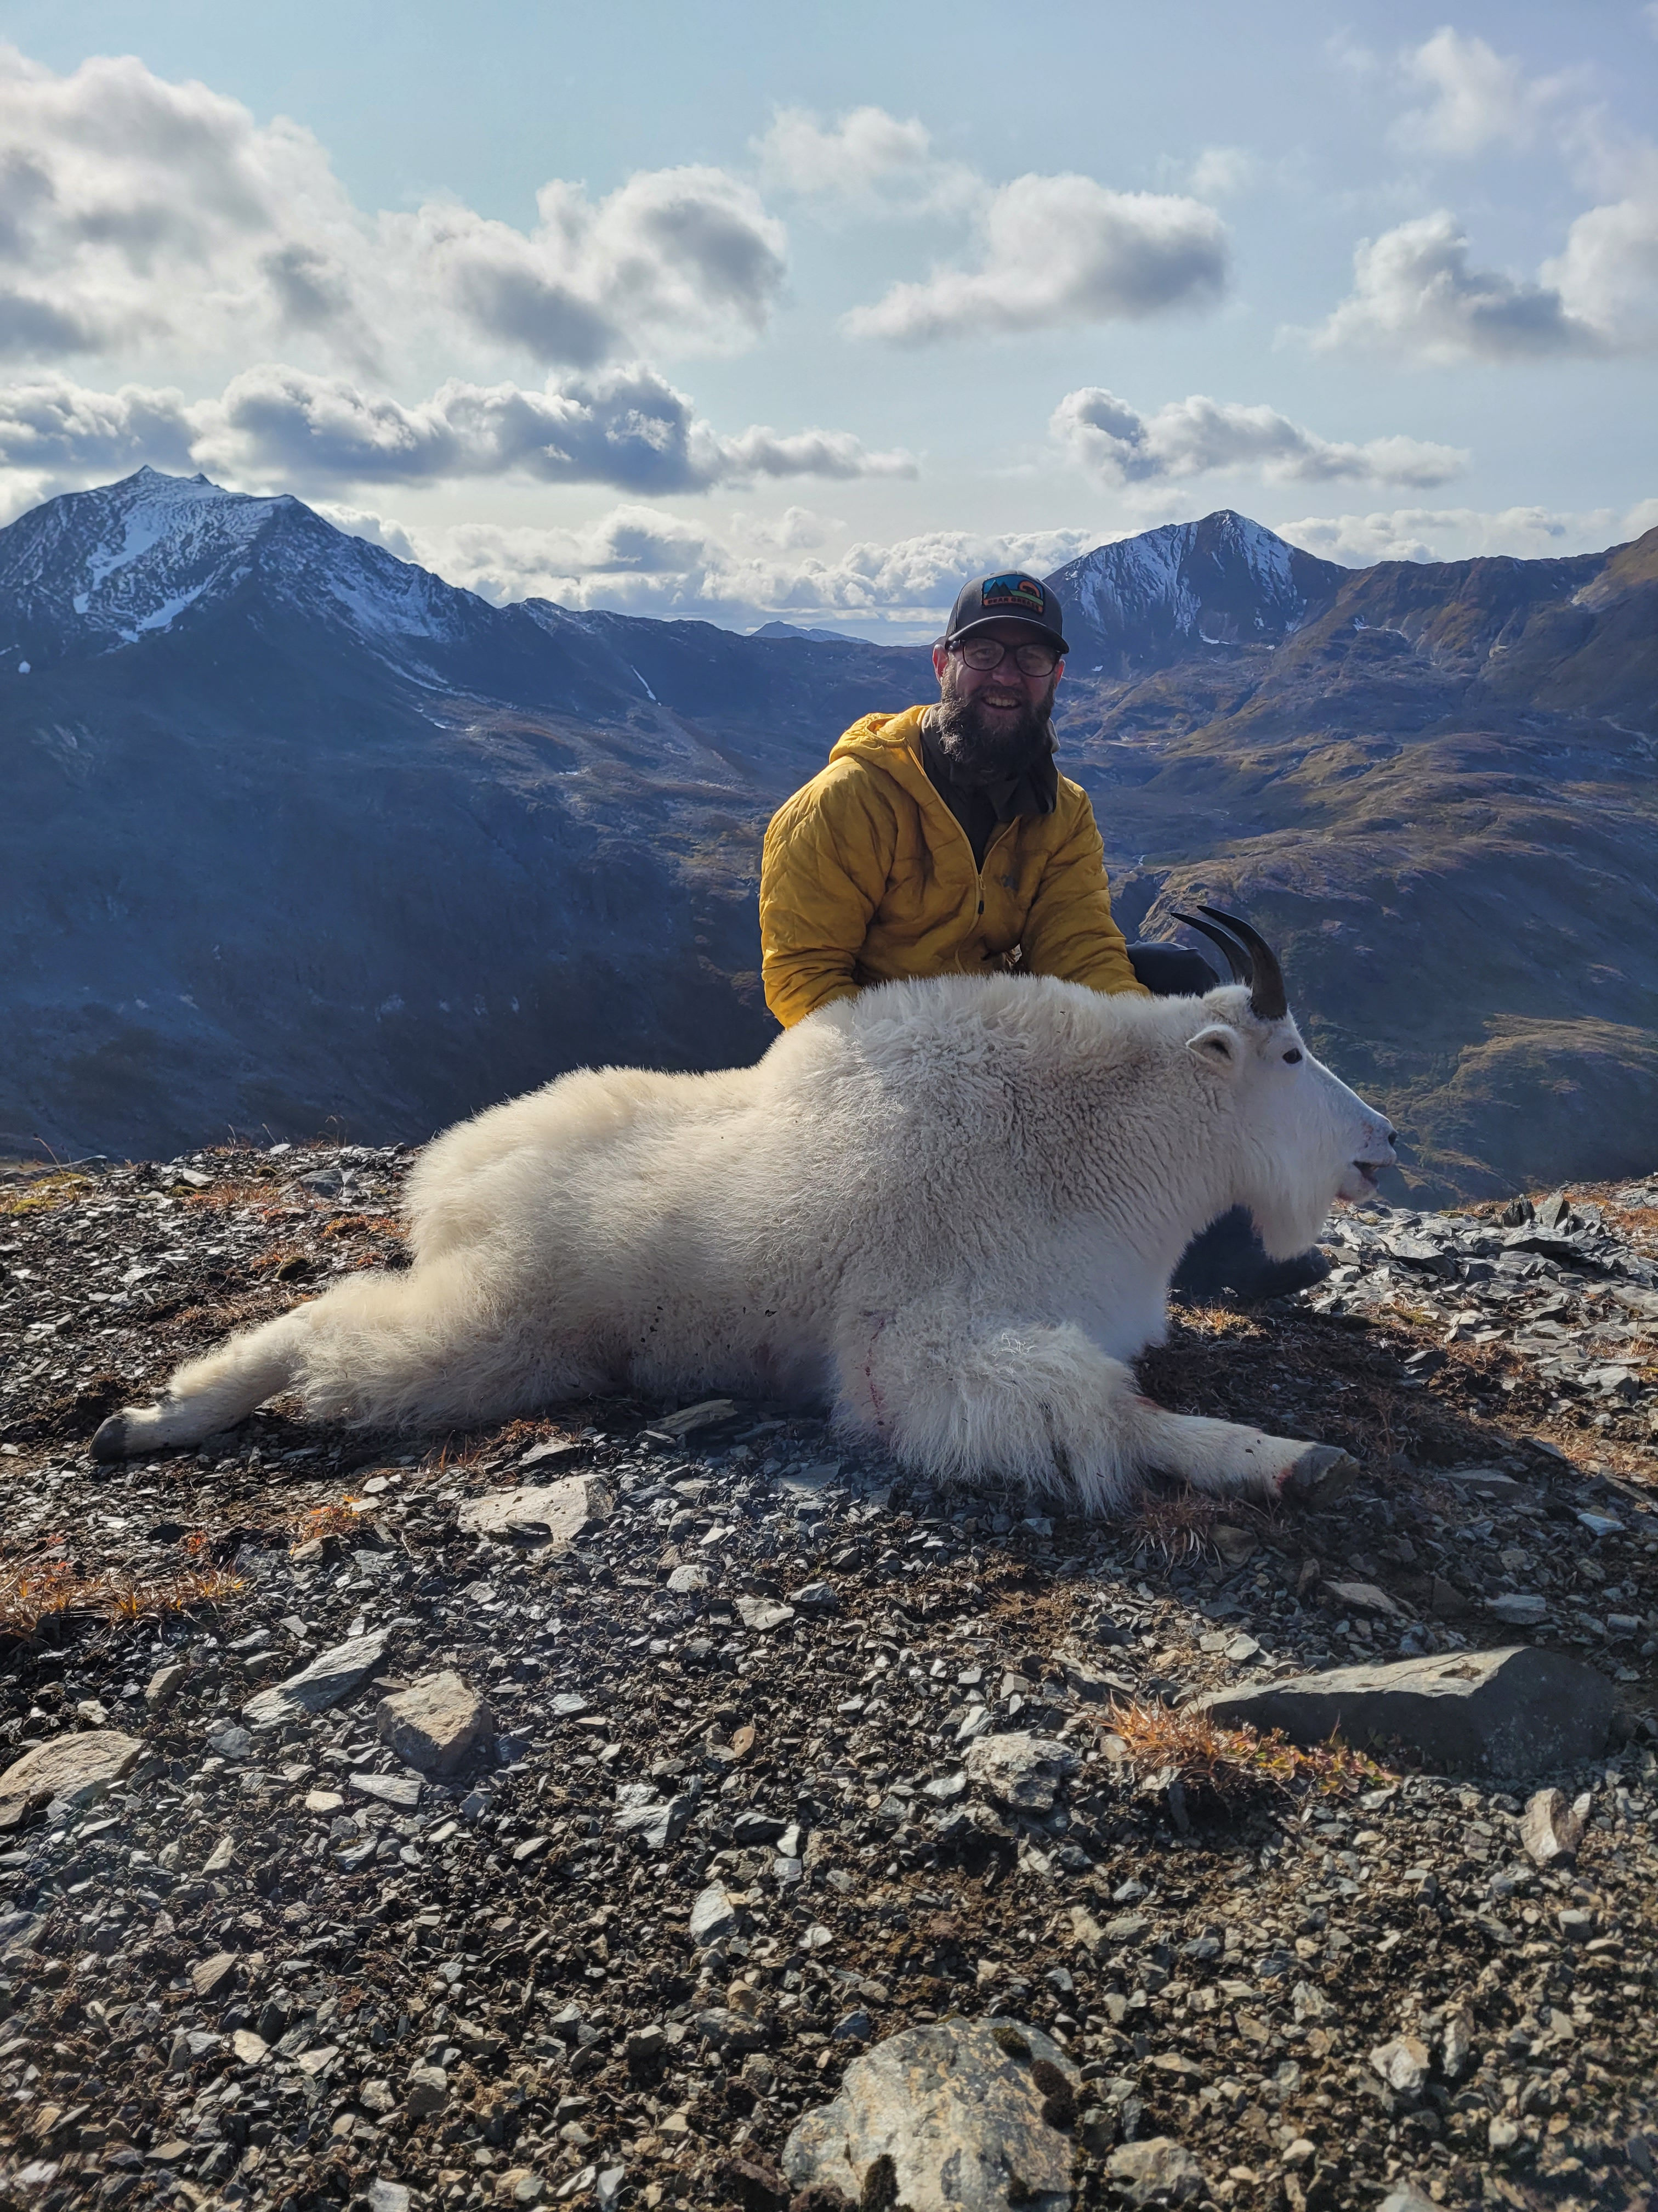

Goa pacific cod
P. hulson, s. barbeaux, b. ferriss, k. echave, J. Nielsen, S. McDermott, b. laurel, a. abookire, Ingrid spies, and s. k. shotwell
November 2024, Presentation to the GOA Plan Team

Slide 2
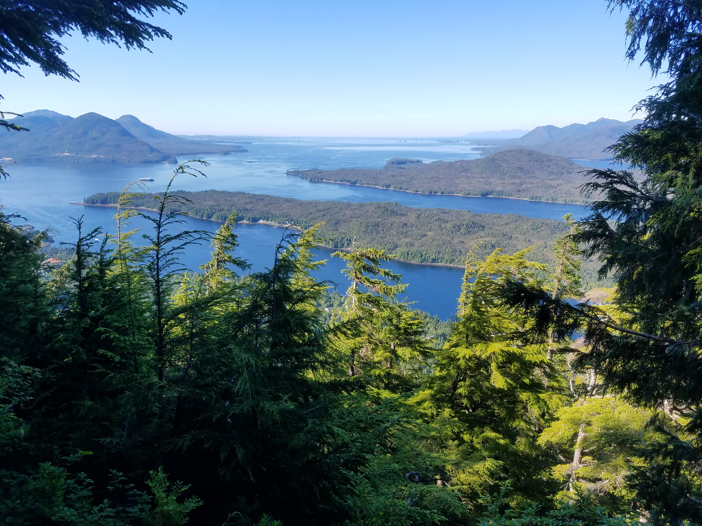
Assessment overview
BLUF:
GOA Pacific cod: Tier 3b
2024 projected spawning biomass to be at B_{28.7%}
2025 recommended ABC <1% different than 2024 ABC
Outline:
SSC/Plan Team comments
Summary of changes from 2023 assessment
2024 recommended model results

Slide 3
Ssc/plan team comments: General
“The SSC continues to support a three-category risk table with categories normal, increased, and extreme, and requests that the category descriptions be revised to cover the range covered by the original table.”
“The SSC reiterates that only fishery performance indicators that provide some inference regarding biological status of the stock should be used.”
“The SSC recommends that the risk tables consider potential future risks when these can be anticipated.”
“When risk scores are reported, the SSC requests that a brief justification for each score be provided, even when that score indicates no elevated risk.” (SSC, Dec 2023)

Slide 4
Ssc/plan team comments: General
“The SSC requests that when Bayesian model output is reported, basic convergence diagnostics are also presented.” (SSC, Dec 2023)
“The Team recommended as a best practice that appendices be linked in the front of the document (as with the sablefish assessment) to allow for an easier review of the appendices.” (Plan Team, November 2023)

Slide 5
Ssc/plan team comments: specific
“The SSC appreciates the preliminary evaluation of conditional age-at-length patterns and recommends further evaluation of growth-related issues, including updating the length-weight relationship with more recent data, evaluating if there have been significant growth changes, and examining empirical weight at age. The SSC encourages consistency with EBS and AI cod assessments in approaches to these and other issues, where possible.” (SSC, Dec 2022)
“The Team recommended that the data for length-weight relationships be reevaluated and examined for sensitivity to the trends over time and areas.” (Plan Team, Nov 2022)
“The Team recommended the authors look at the model-predicted mean weight-at-age (by gear type), and compare to the observed weight-at-age data to see if there are discernible spatial or temporal patterns that the model is missing.” (Plan Team, Nov 2022)
“The Team recommended that an evaluation comparing how growth changes may affect the residuals be pursued. The Team also recommended the author investigate whether size-based selectivity affects the patterns observed.” (Plan Team, Nov 2022)
“Based on recent tagging and genetic studies, the SSC encourages further exploration of fish movement as a potential major cause of population changes. Movement should be considered in concert with high natural mortality events for future models, and specifically consideration should be given to an Alaska-wide stock or GOA/EBS model.” (SSC, Dec 2022)
Krista Oke
?

Slide 6
Ssc/plan team comments: specific
“The SSC reiterates its encouragement for the authors to consider whether information from the IPHC setline survey and NMFS longline survey, alongside the NMFS bottom trawl survey, may provide a superior basis for apportionment recommendations, perhaps through the use of an integrated spatiotemporal model or a multi-survey random effects model.” (SSC, Dec 2023)
“The SSC requests the authors evaluate the utility of the 14 forecast recruitment deviations. It is not clear where they are used in the document and whether they affect the estimation of other parameters.” (SSC, Dec 2023)
“The Team recommended the author only bring forward their preferred model as “2024” in November, in addition to the base model used in the previous assessment.” (Plan Team, Sept 2024)

Slide 7
Ssc/plan team comments: specific
“The Team recommended using Akaike Information Criterion (AIC) to inform selection of the aging error model.” (Plan Team, Sept 2024)
“The Team also noted that weight-at-age is produced as a standard output of this model (as it is needed to fit the catch biomass), and recommended comparing the model-estimated weight-at-age to empirical data on weight-at-age.” (Plan Team, Sept 2024)
“The SSC requests a thorough revaluation of the current modeling approach for survey selectivity and catchability, including alternatives to the current selectivity blocks in the trawl survey, and alternatives to a strongly dome-shaped selectivity in the longline survey, and whether selectivity rather than catchability is more appropriately modeled with a time-varying temperature covariate.” (SSC, Dec 2023)

Slide 8
Ssc/plan team comments: specific
“The Team recommended that sufficient samples be processed and analyzed so that the resulting data can be used in the assessment.” (Plan Team, Nov 2023)
“The SSC supports the GOA GPT recommendation to work up the backlog of maturity data, and further to evaluate trends in maturity, as well as relationships between growth and maturity.” (SSC, Dec 2023)

Slide 9

Assessment evaluation Outline
Data
Fishery
Results
Alt model eval
Recommendations
Risk table
ABC/OFL
Surveys
Other
Derived quantities
Diag/Fits

Slide 10

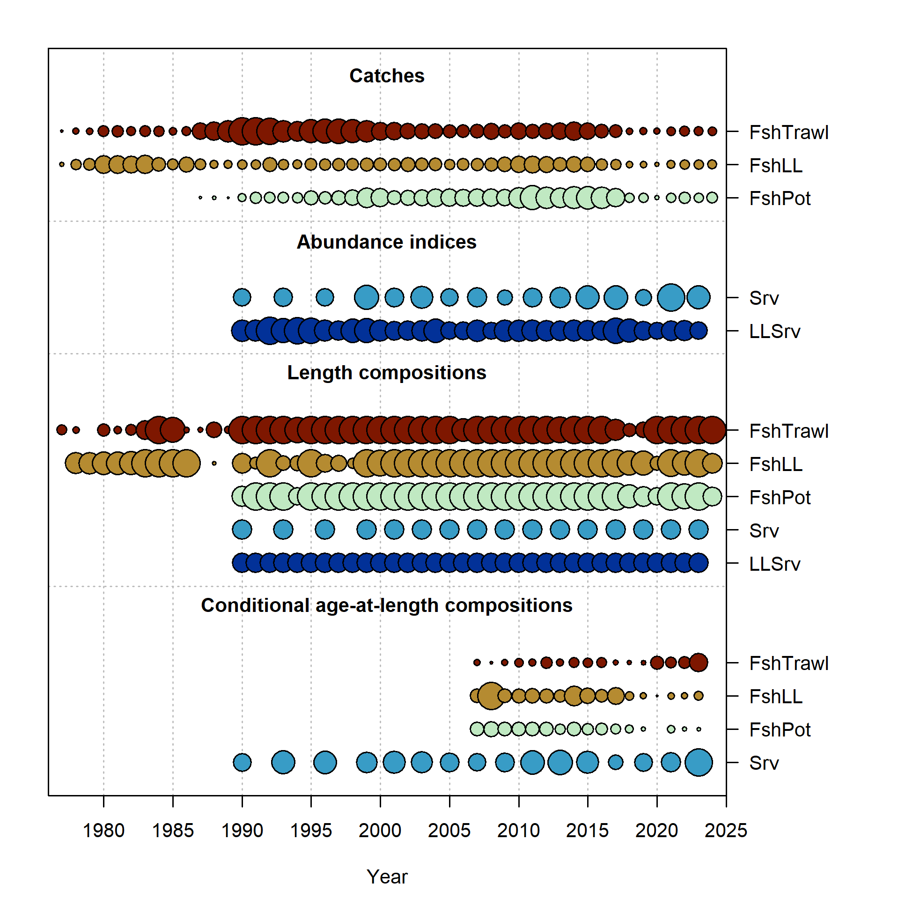
Data overview
New Data | Years
Federal and state fishery catch, by gear type | 2023, 2024
Federal and state fishery length composition, by gear type | 2023, 2024
Federal fishery conditional age-at-length | 2023
GOA AFSC bottom trawl survey conditional age-at-length | 2023

Slide 11
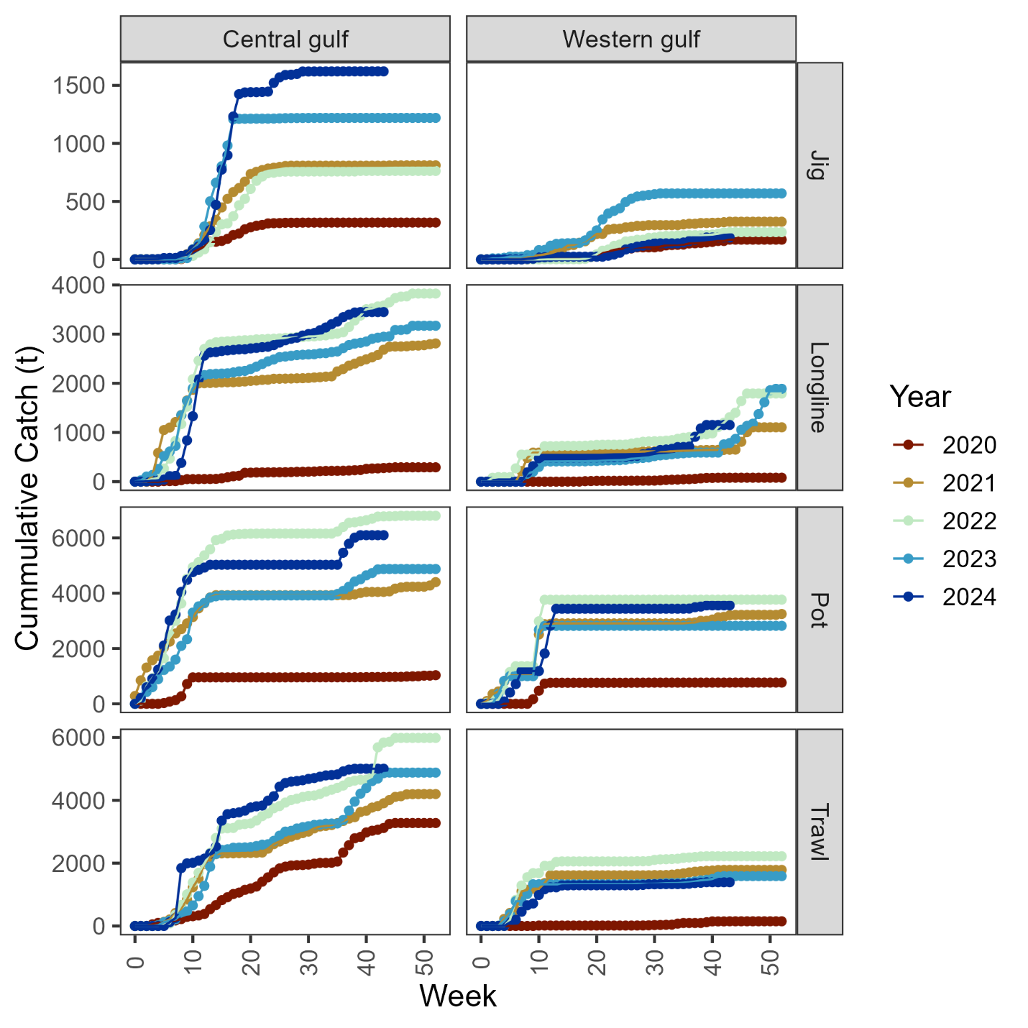
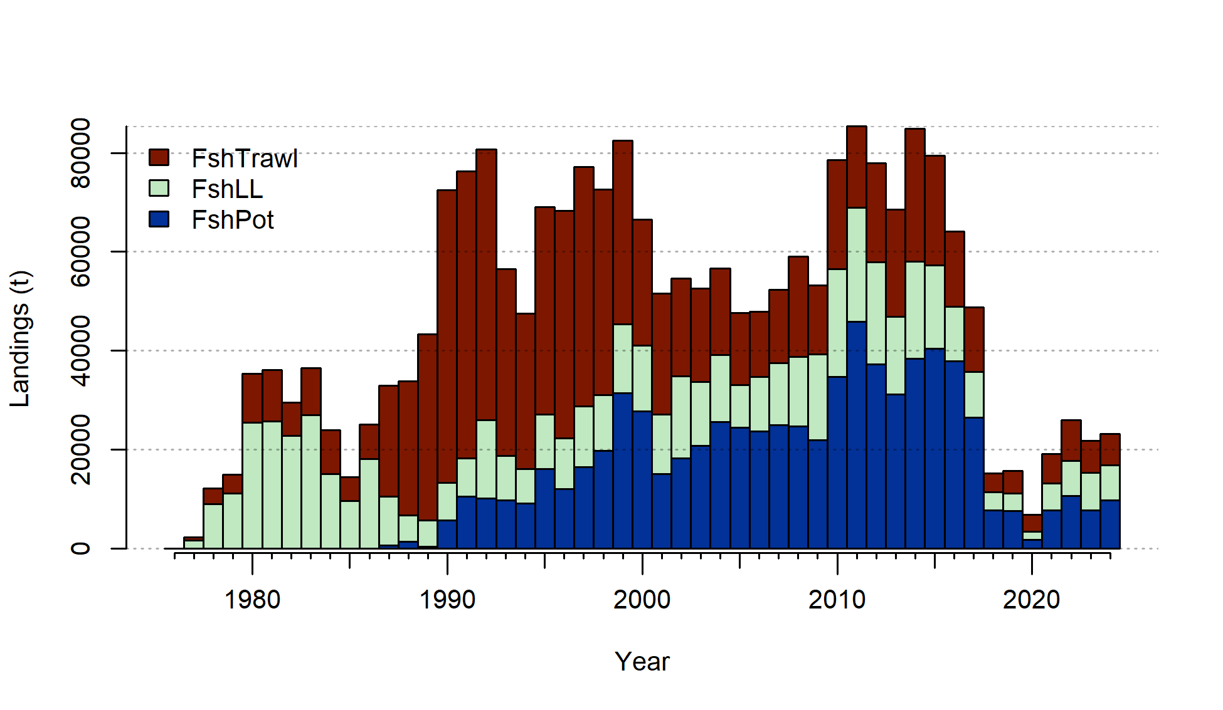
Data - Catch
Increased since 2023
Pot majority > LL > Trawl
Large jig increase in CGOA and decrease in WGOA
Others similar to what was seen in 2022

Slide 12
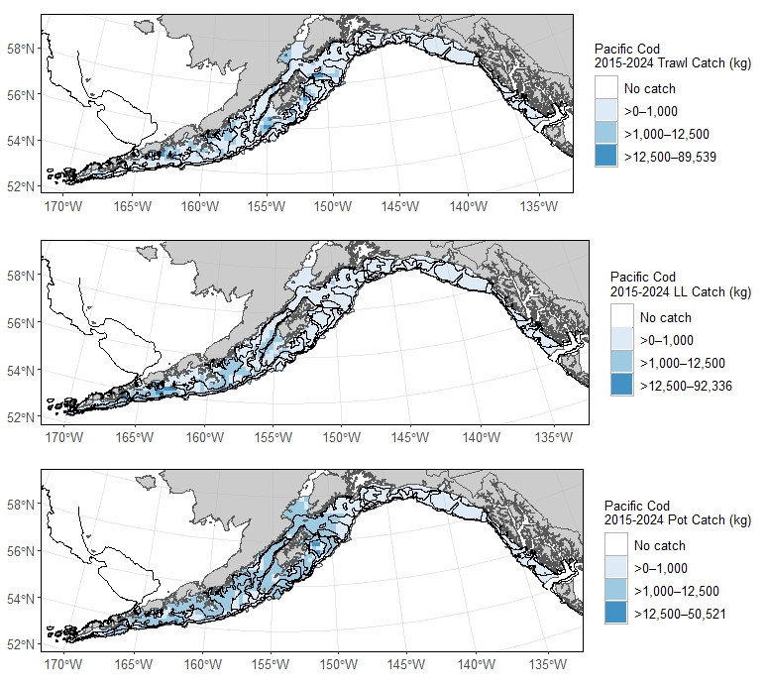
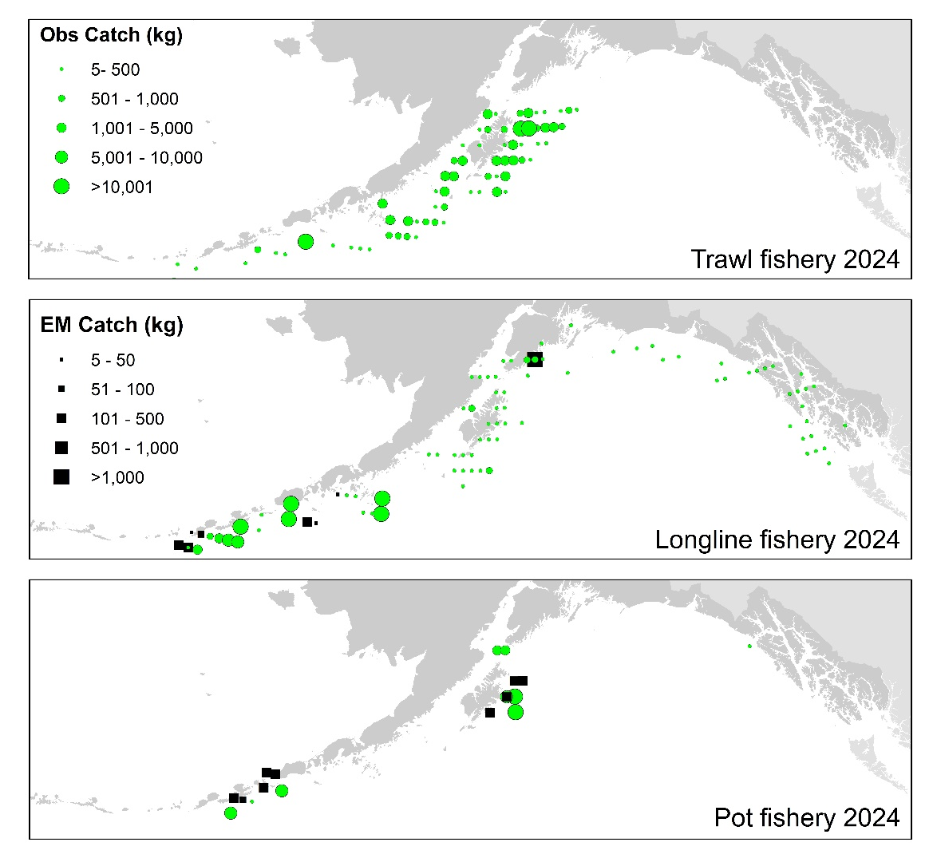
Data – Catch distribution
2024 distribution similar to catch distribution since 2015
For how much relative catch is taken by pot, small # observed hauls

Slide 13
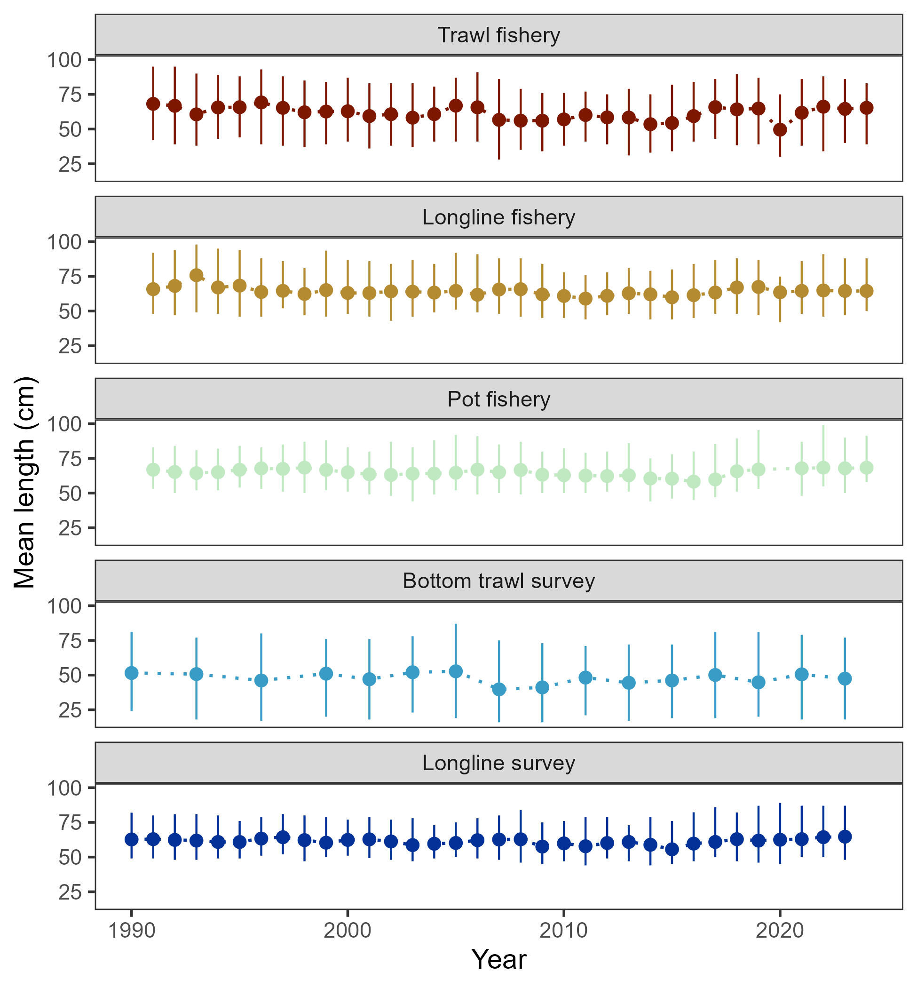
Data – length comps
In general, mean length in 2024 similar to that in previous 4 or so years

Slide 14
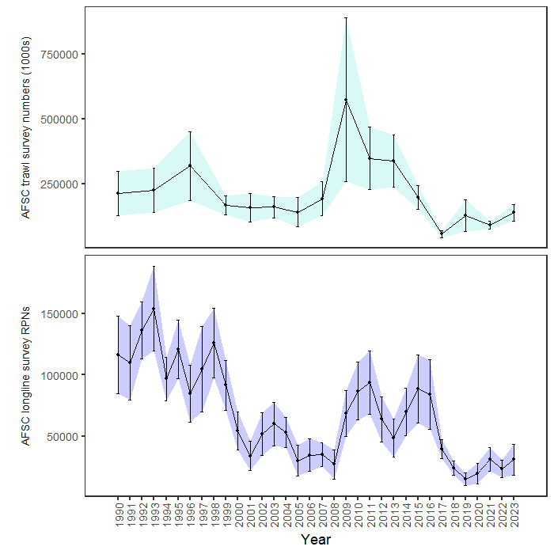
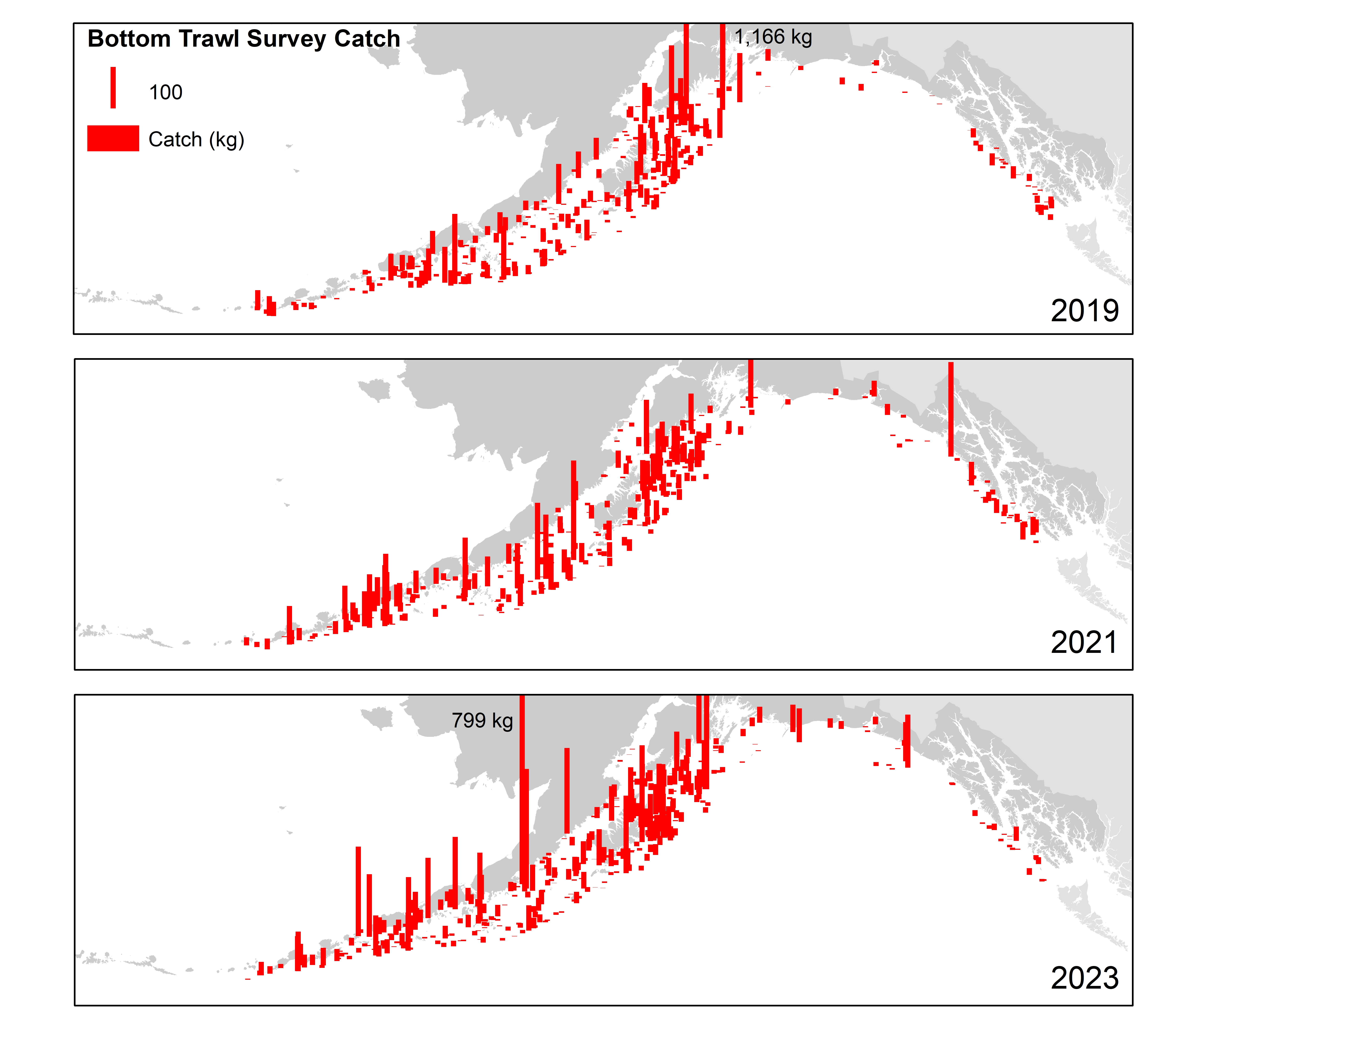
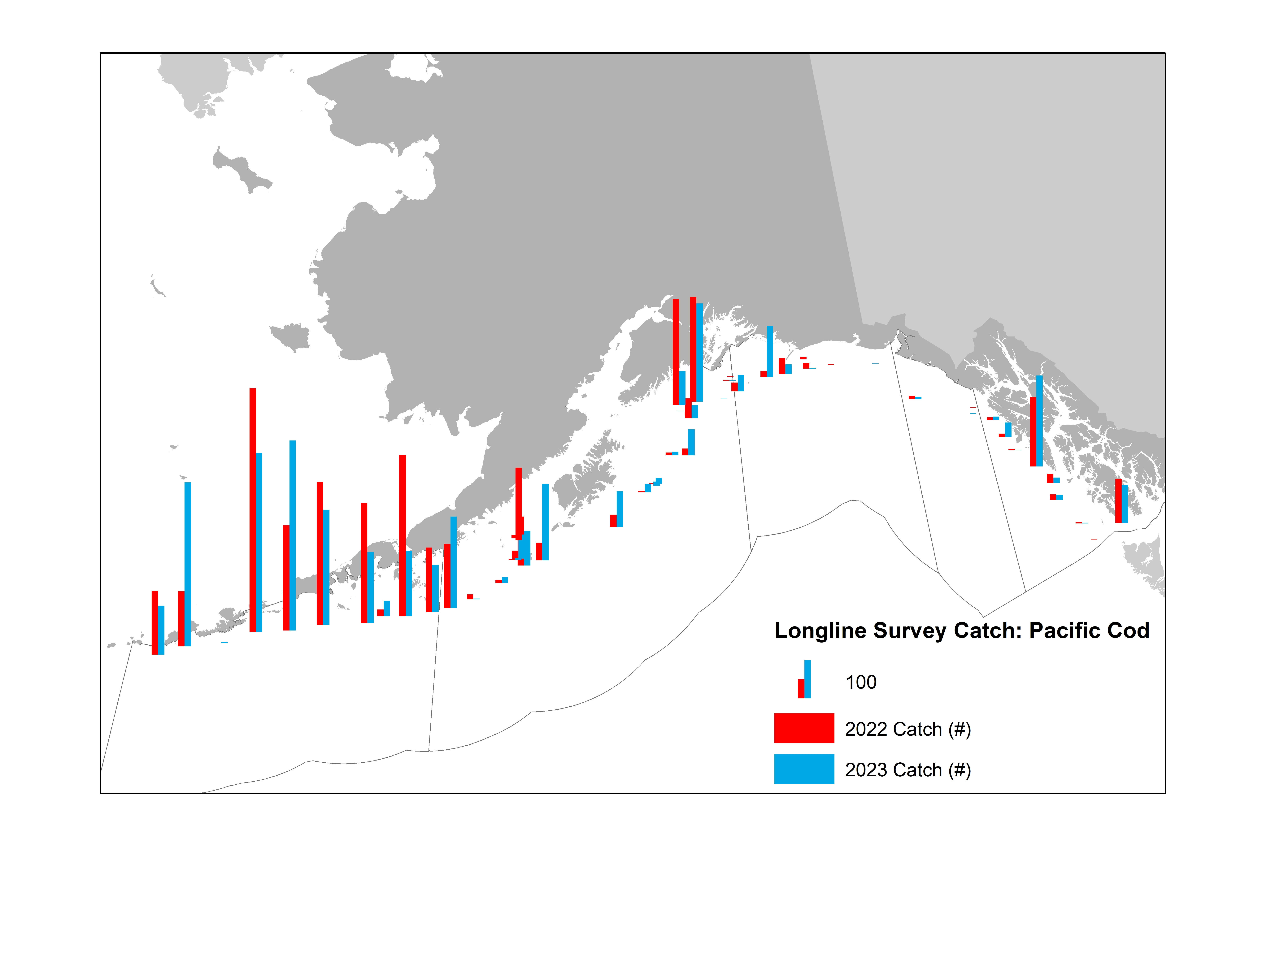
Surveys – fitted (from 2023)
+53%
+32%

Slide 15
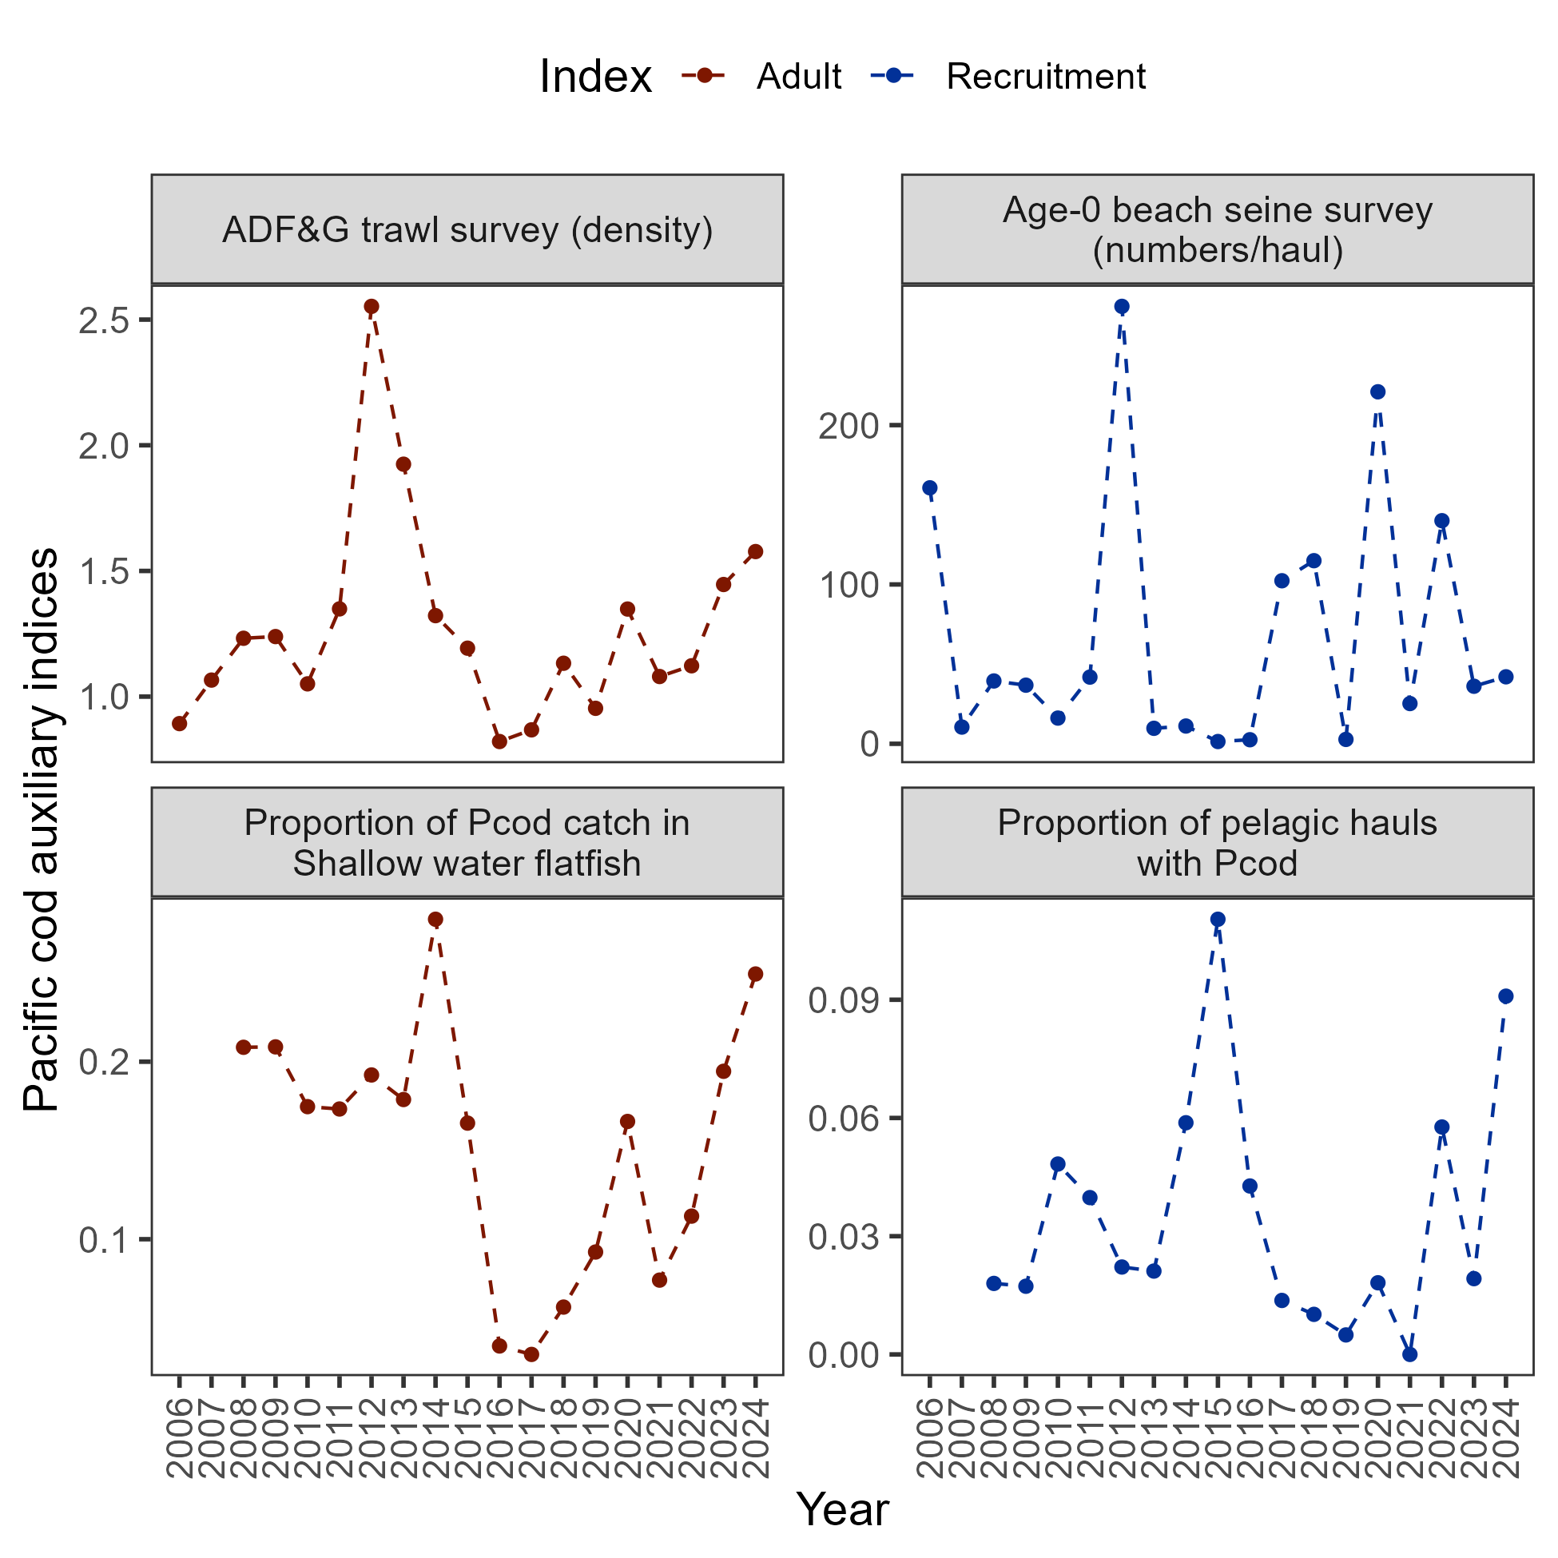
Data – auxiliary information
+9%
+28%

Slide 16

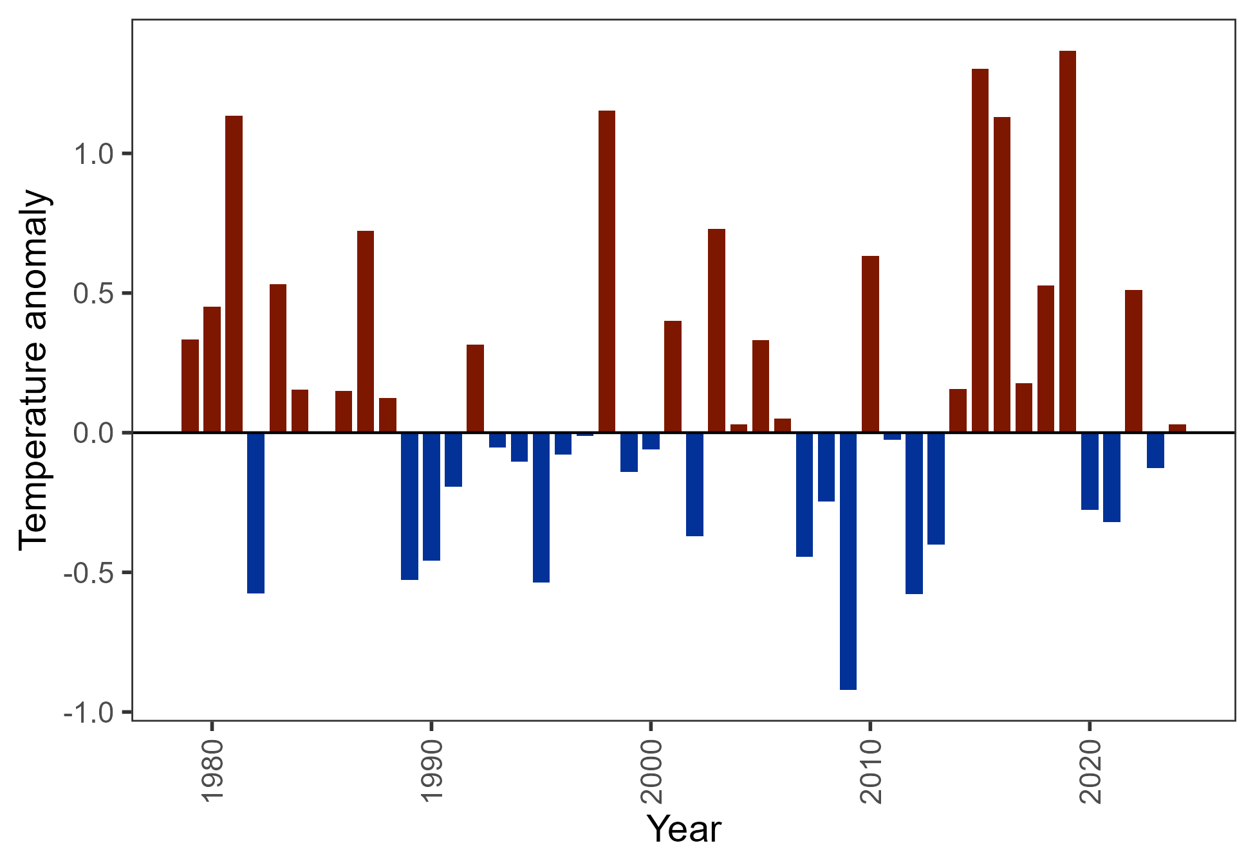
Surveys – Env data
CFSR bottom temperature below mean in 2023, slightly above in 2024

Slide 17
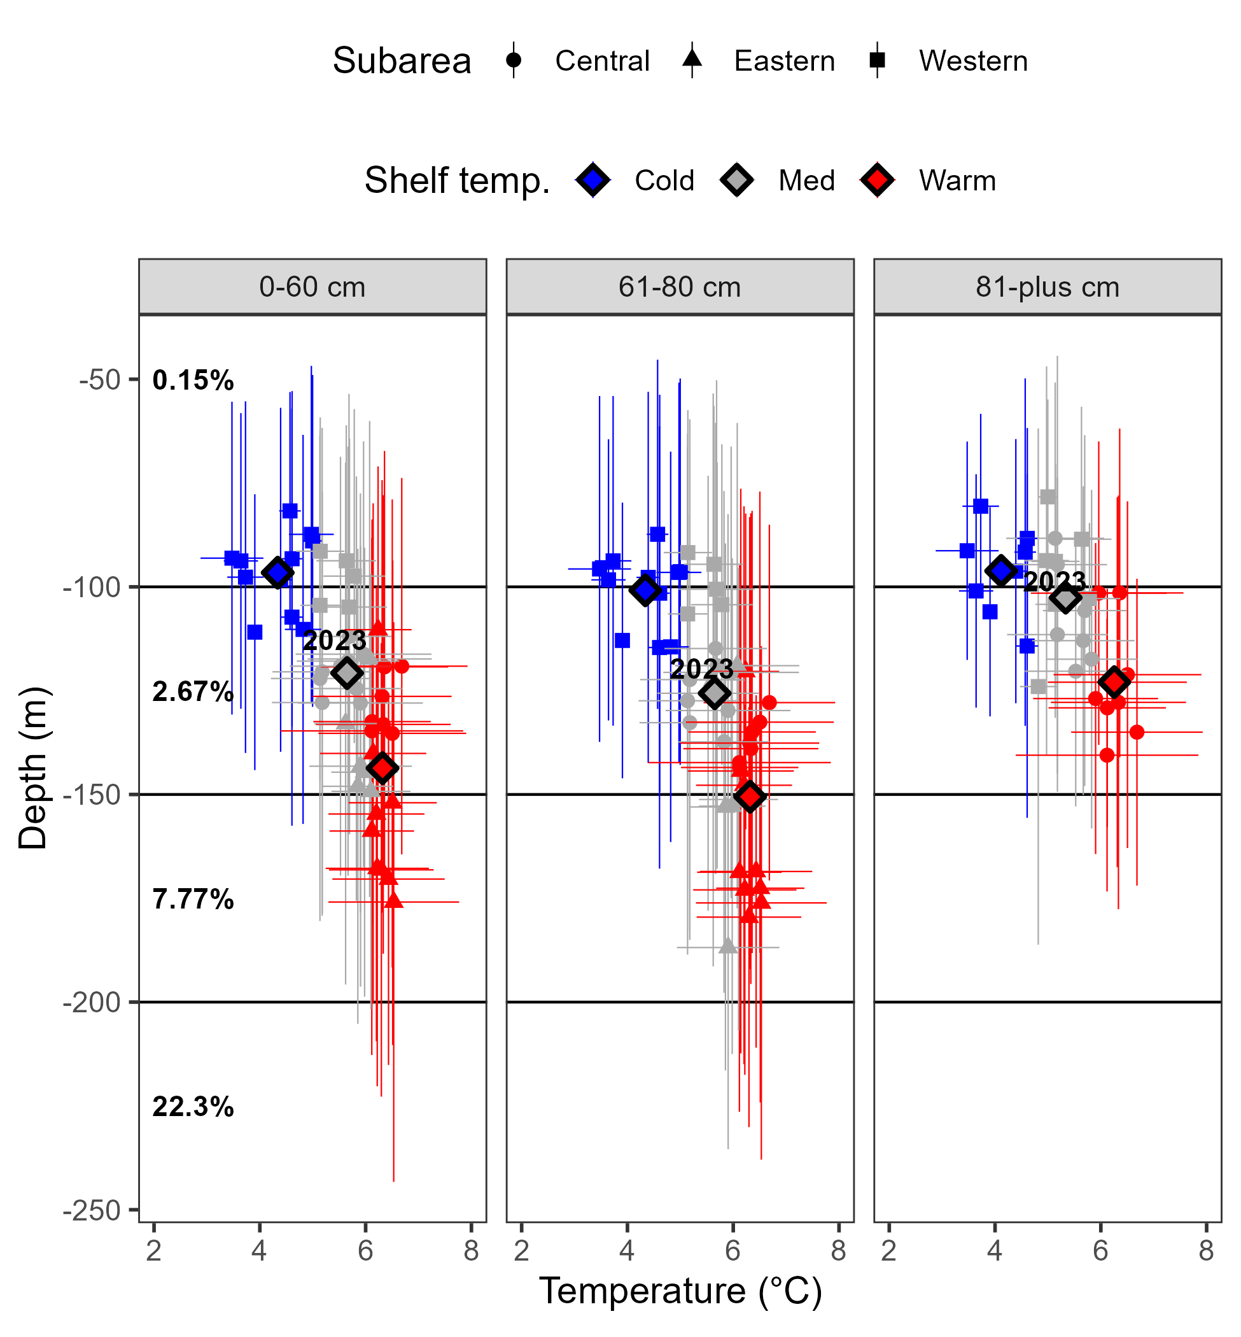
Surveys – Env data
Cod depth distribution related to temperature, variable overlap with AFSC longline survey distribution

Slide 18
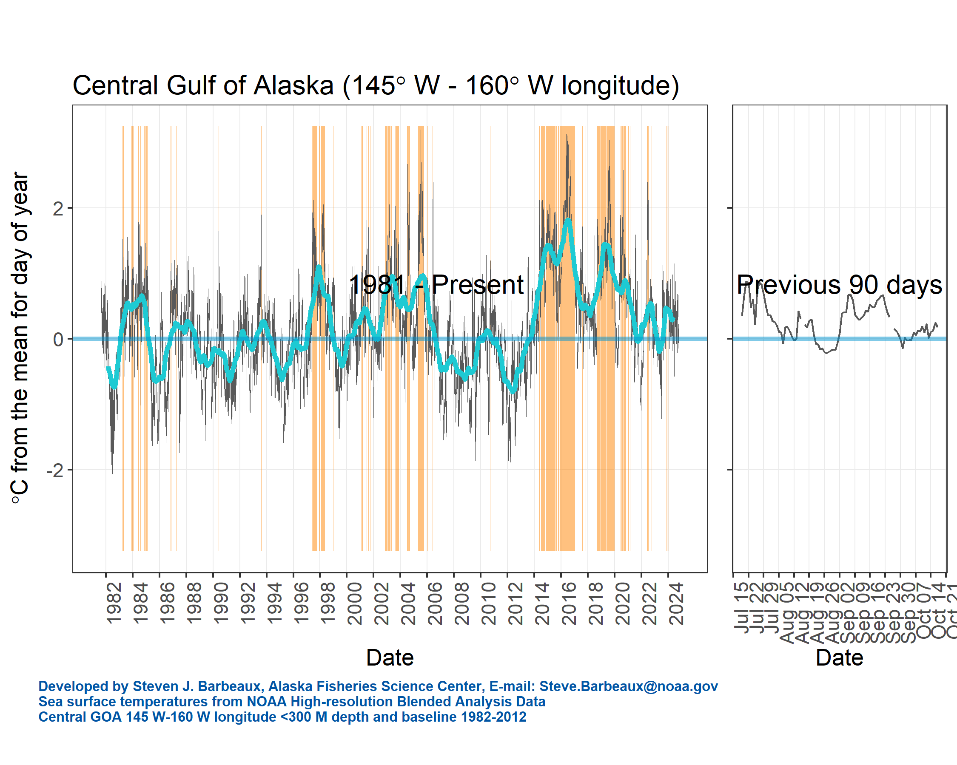
Surveys – Env data
Above avg sea surface temperature, but not like seen before

Slide 19
Data – summary
Length comp trends:
No red flags, recent lengths consistent
Index trends:
Environmental trends:
2024 average year, no red flags
Available auxiliary sources increased in 2024

Slide 20
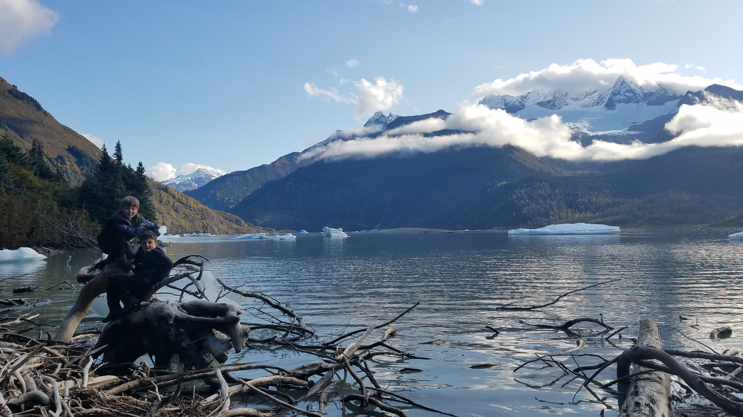
results
Alternative model comparison
Data fits
Parameter/Time series results
Model diagnostics
Recommendations

Slide 21
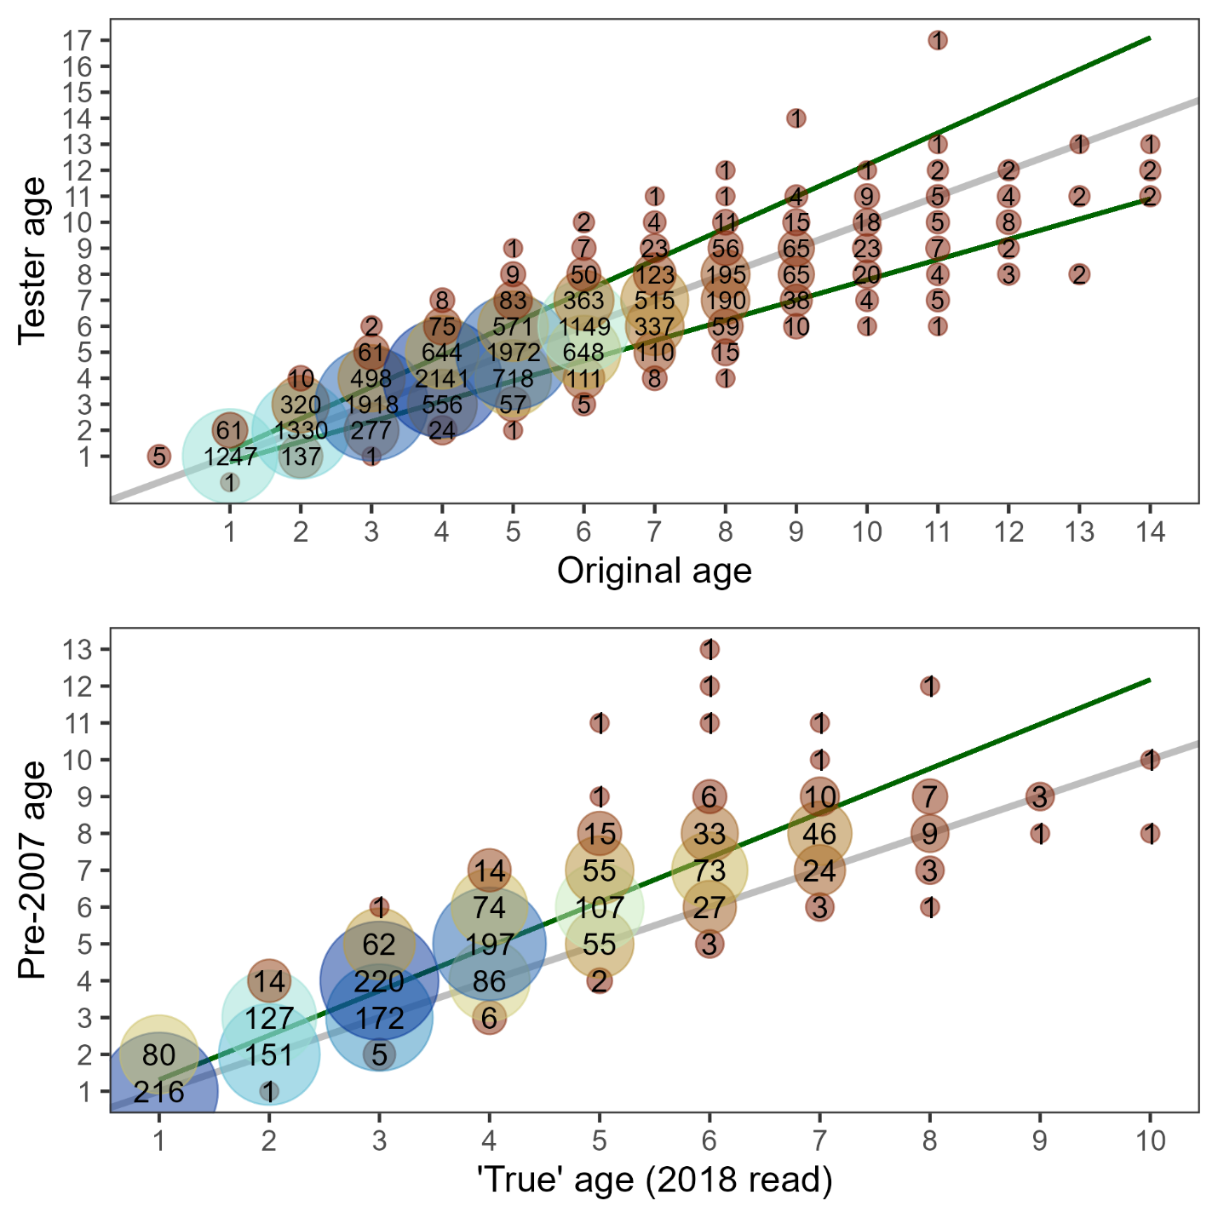
Results: alt. models
19.1c: input file corrections (Appendix 2.2)
19.1d: update ageing error & bias (AgeingError)
Combined EBS & GOA
Linear (AIC pref): start at age-1
Bias fixed rather than estimated

Slide 22
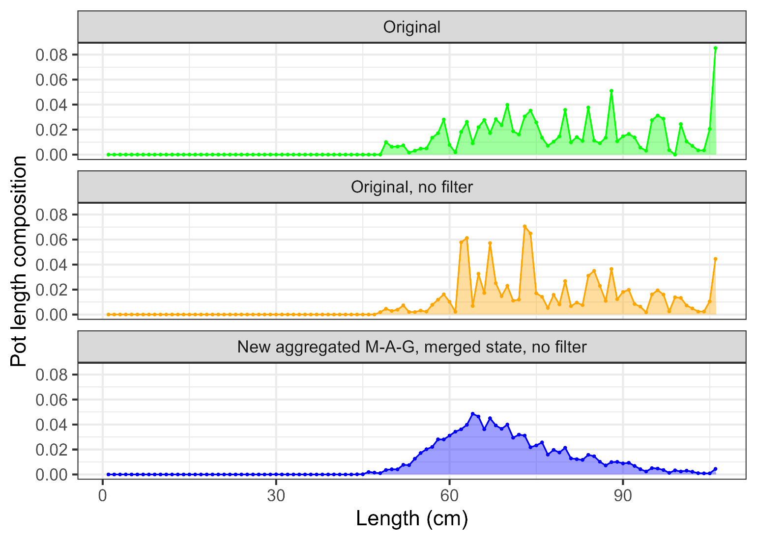
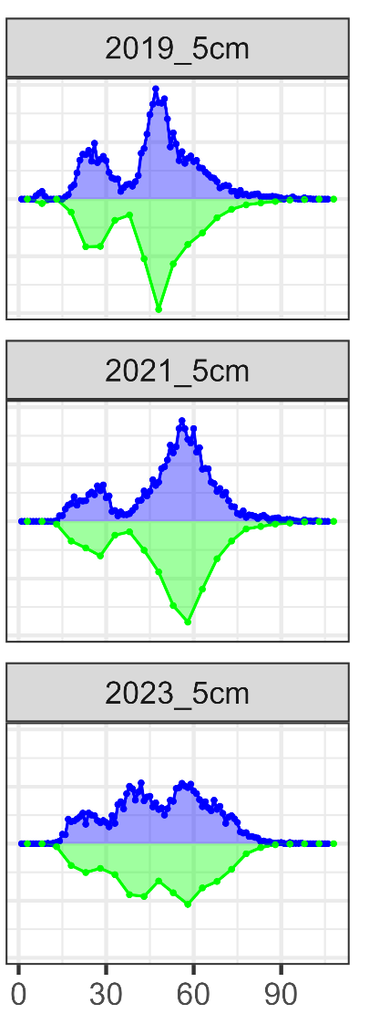
Results: alt. models
19.1d: new method to compute fishery length comps:
Weekly → Monthly
Use all ADF&G data
Remove filters
24.0: 1 → 5 cm bins

Slide 23
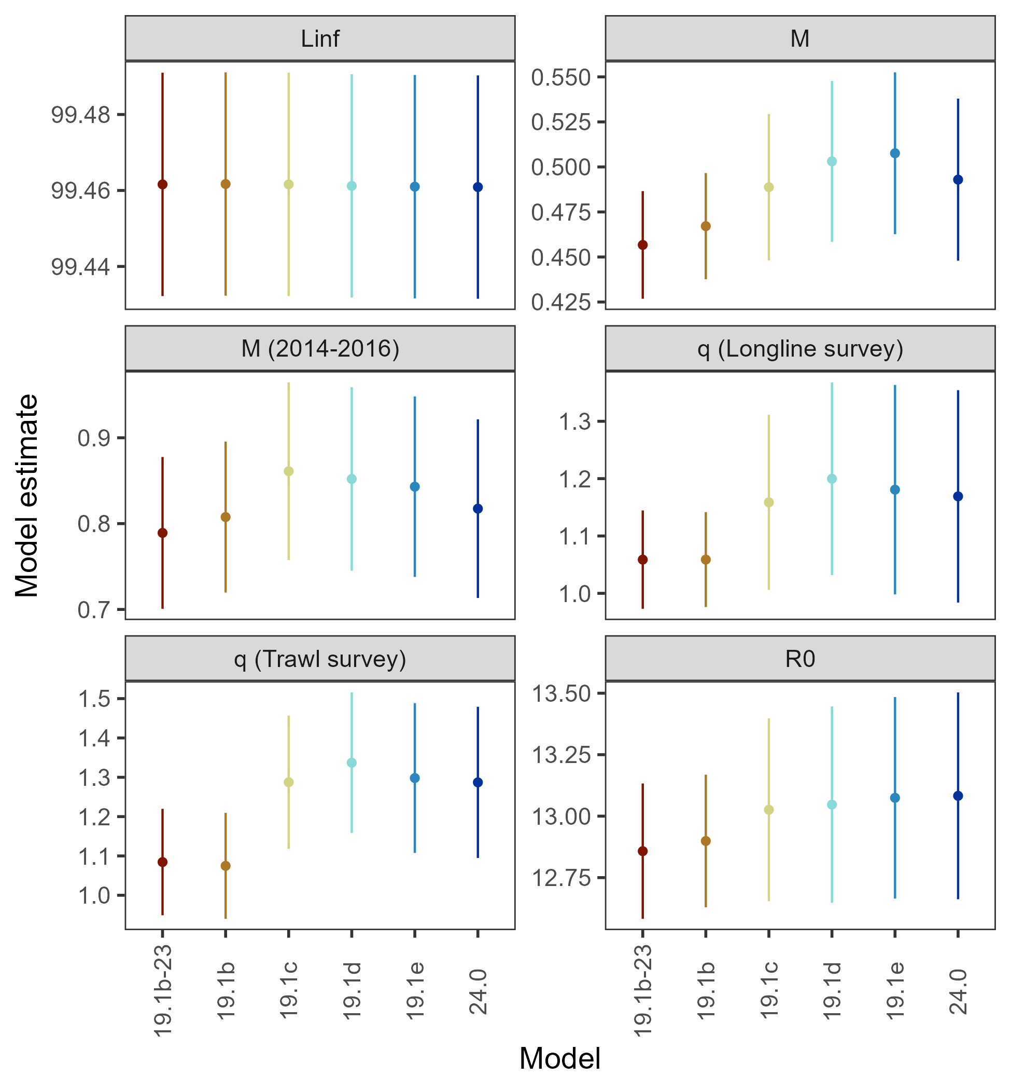
Results: alt. models
Largest shift in parameter estimates occurred in the 19.1c transition

Slide 24
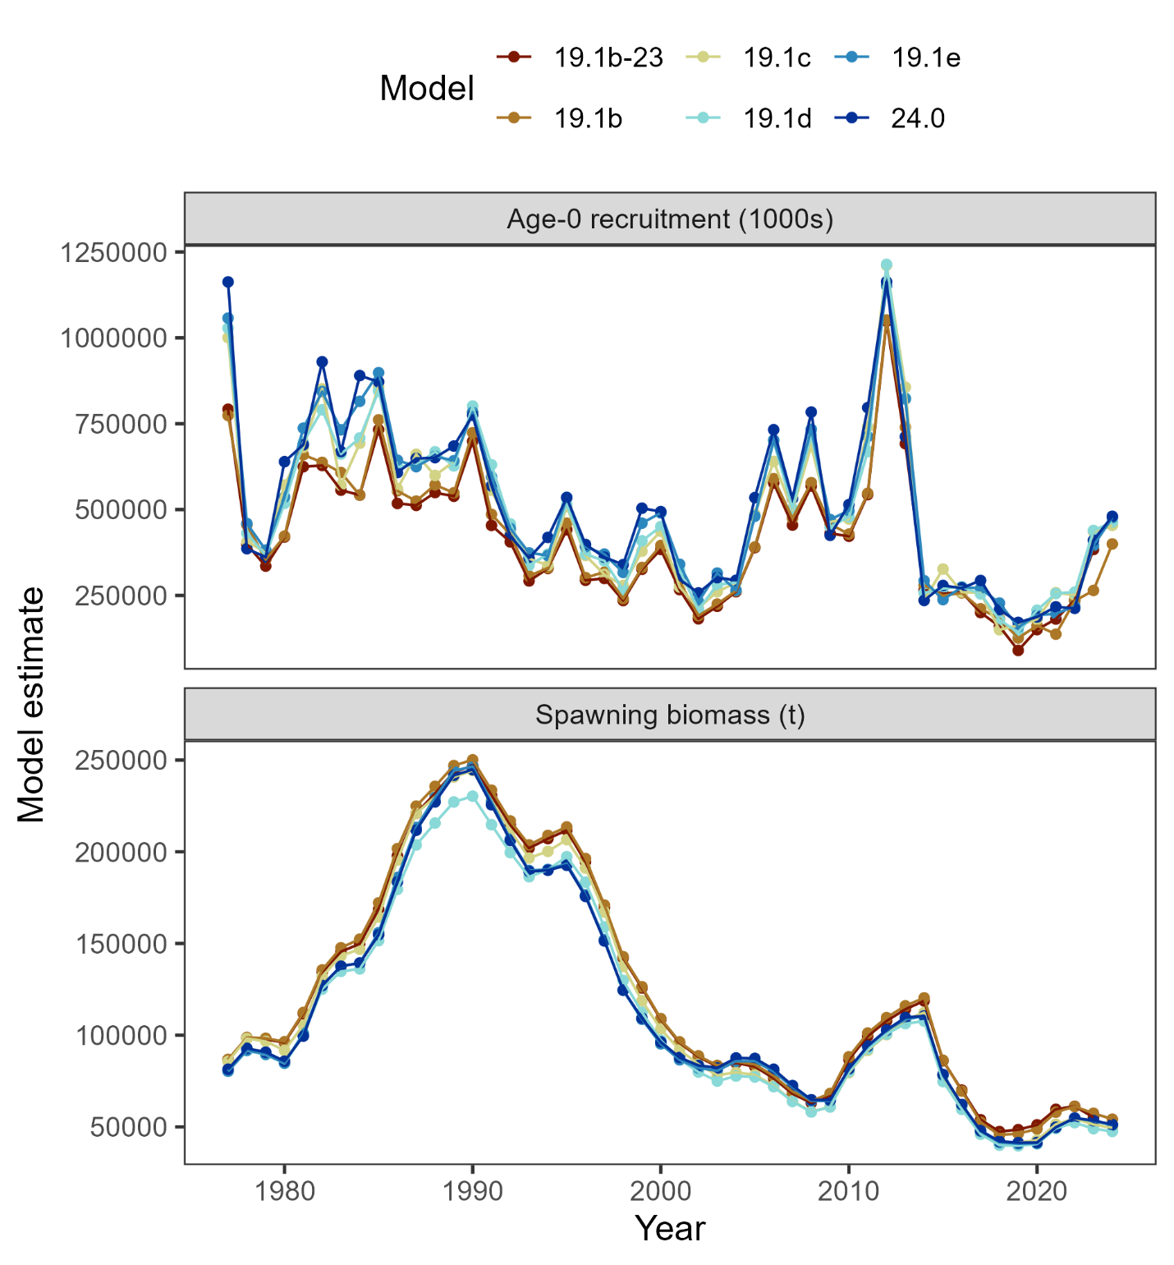
Results: alt. models
In general, consistent estimates of recruitment & spawning biomass

Slide 25
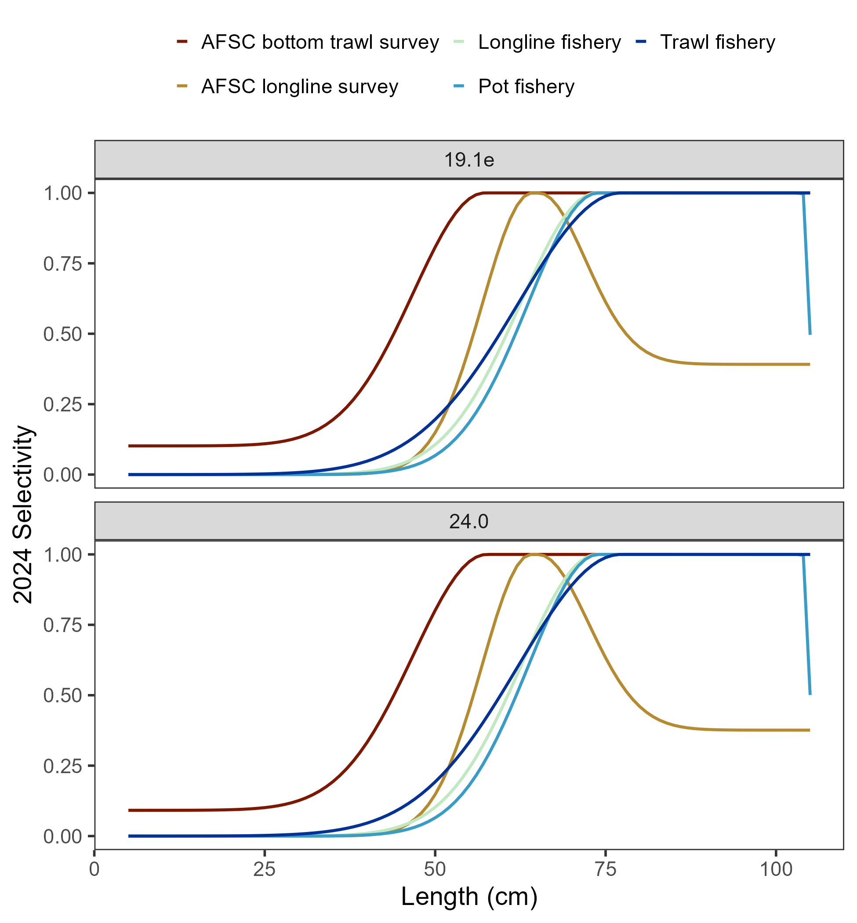
Results: alt. models
No discernable difference in, for example, selectivity when shifting from 1 → 5 cm bins
But, improvement in ISS/ESS
Component | 19.1b-23 | 19.1b | 19.1c | 19.1d | 19.1e | 24.0
Length composition mean ISS/ESS | 0.35 | 0.35 | 0.33 | 0.33 | 0.33 | 1.41
Trawl fishery | 0.35 | 0.37 | 0.33 | 0.33 | 0.33 | 1.43
Longline fishery | 0.26 | 0.26 | 0.25 | 0.25 | 0.26 | 1.04
Pot fishery | 0.5 | 0.48 | 0.46 | 0.47 | 0.45 | 2.06
Bottom trawl survey | 0.32 | 0.31 | 0.31 | 0.3 | 0.31 | 1.18
Longline survey | 0.35 | 0.35 | 0.32 | 0.32 | 0.33 | 1.31
Conditional age-at-length mean ISS/ESS | 0.35 | 0.37 | 0.29 | 0.32 | 0.32 | 0.83
Trawl fishery | 0.42 | 0.42 | 0.28 | 0.29 | 0.27 | 0.6
Longline fishery | 0.4 | 0.41 | 0.27 | 0.27 | 0.28 | 0.66
Pot fishery | 0.3 | 0.32 | 0.23 | 0.23 | 0.24 | 0.48
Bottom trawl survey | 0.32 | 0.34 | 0.33 | 0.4 | 0.4 | 1.28

Slide 26
Results: recommended model
19.1c & 19.1d data/model updates
19.1e:
Provides simpler and more efficient method,
serves to smooth variability across lengths,
leverages previously under-used source of information (that is included in total catch).
24.0:
Doesn’t mask any signal in data.
seems to improve statistical attributes of model,
improves model efficiency (reduces run time >50%)

Slide 27
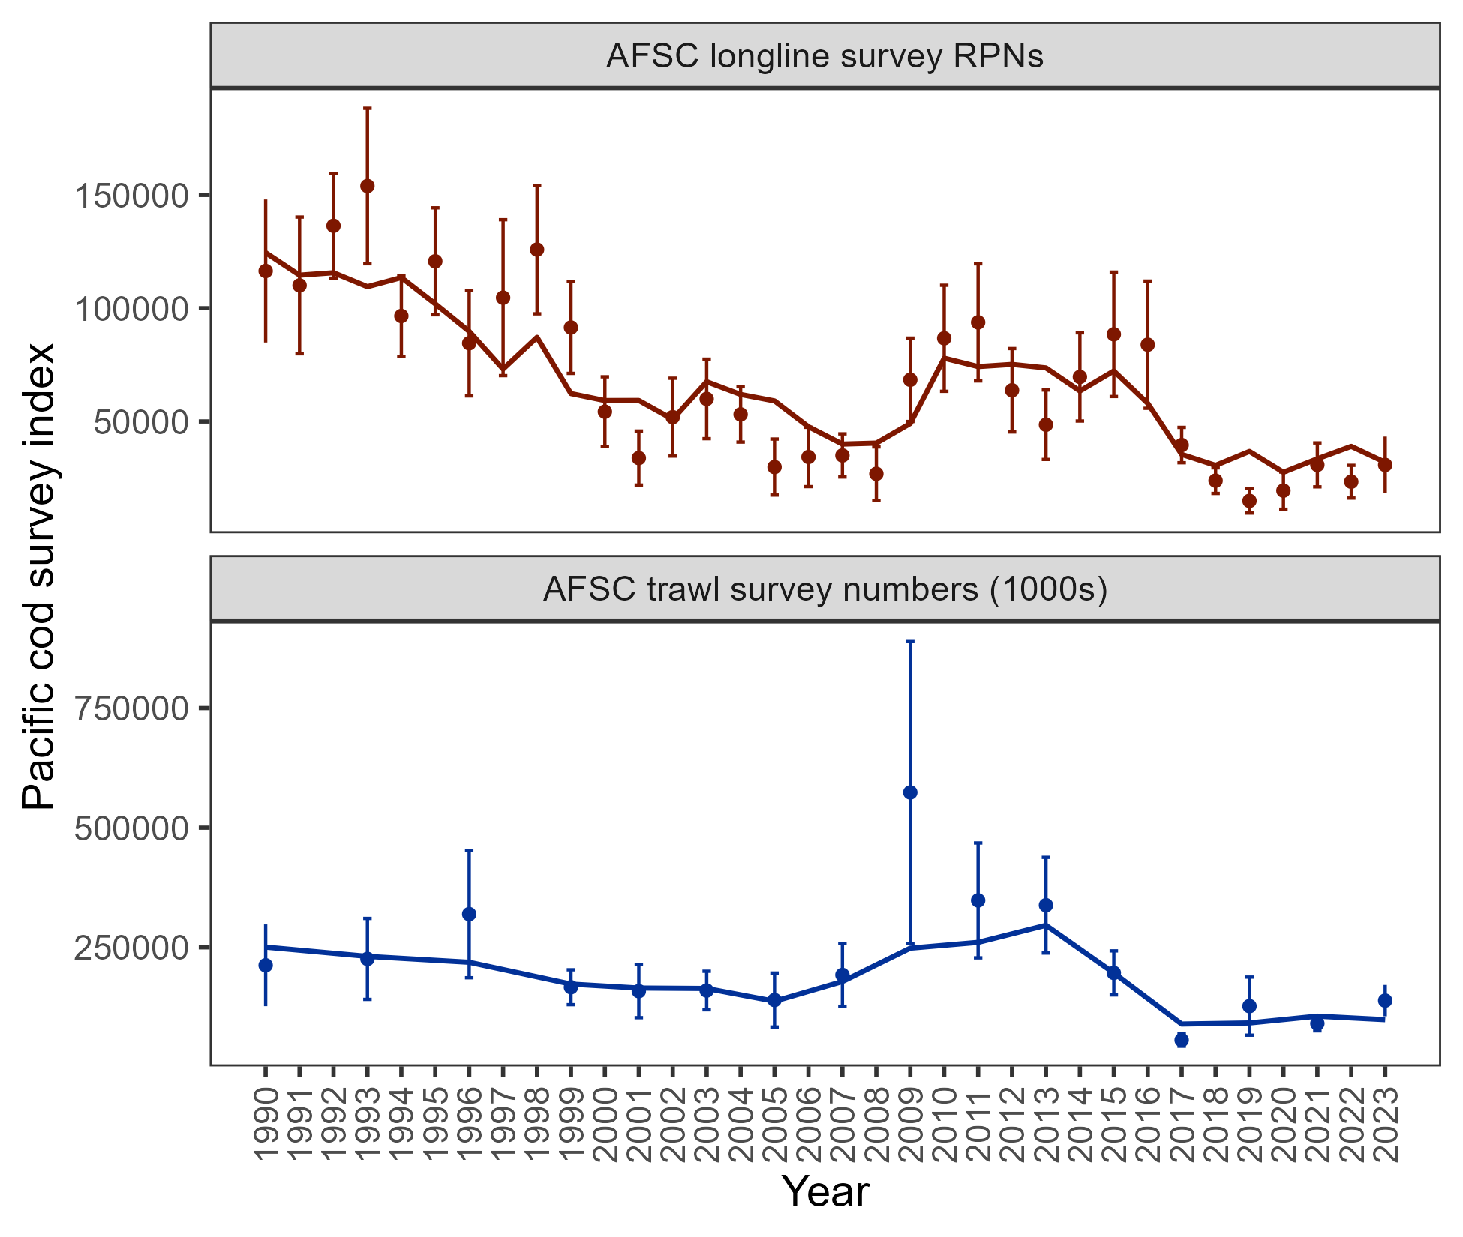
Results: data fits
Pattern of expecting larger RPN from longline survey in 5 of last 6 years, but, model hits 2023
Trawl survey fit between lows in 2017 & 2021 and larger in 2019 & 2023 – model expects less abundance than observed in 2023
Consistent with 2023 assessment

Slide 28
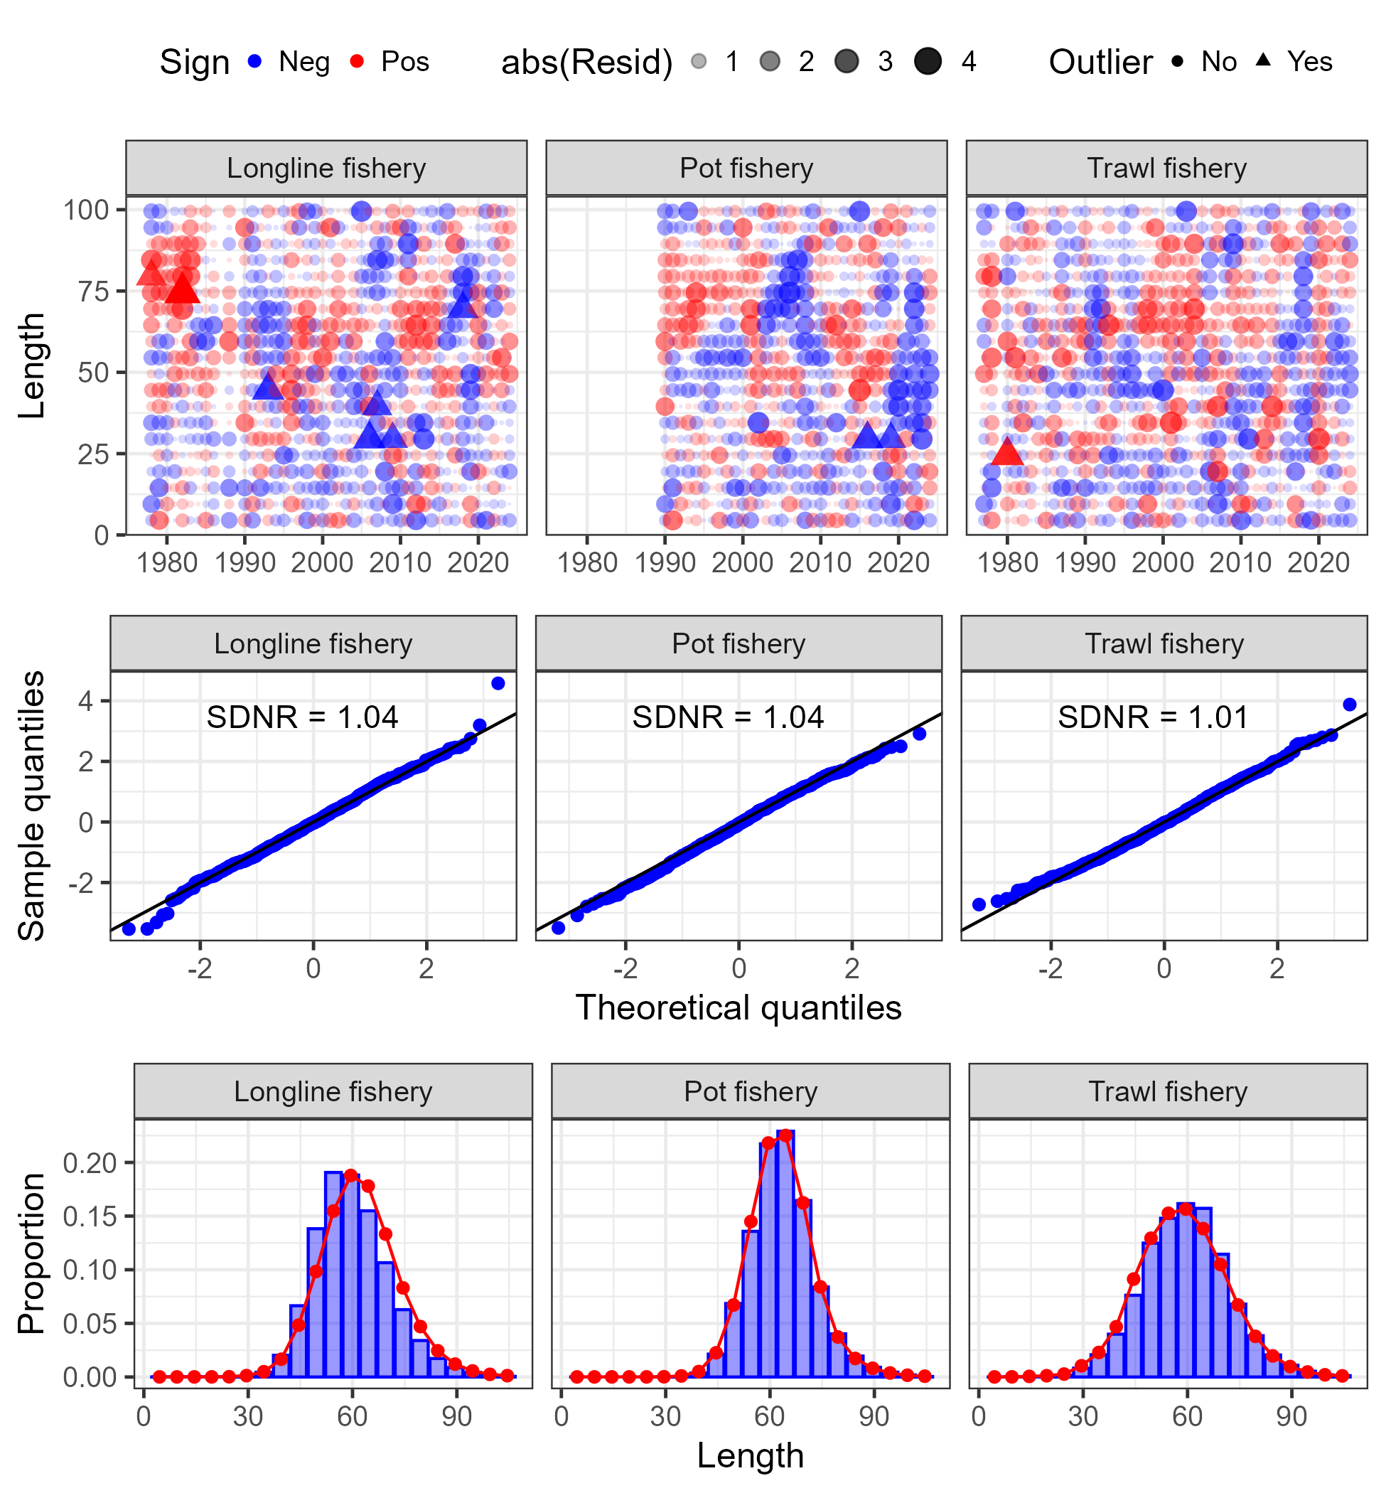
Results: data fits
No glaring sign of model misspecification in fit to fishery length composition

Slide 29
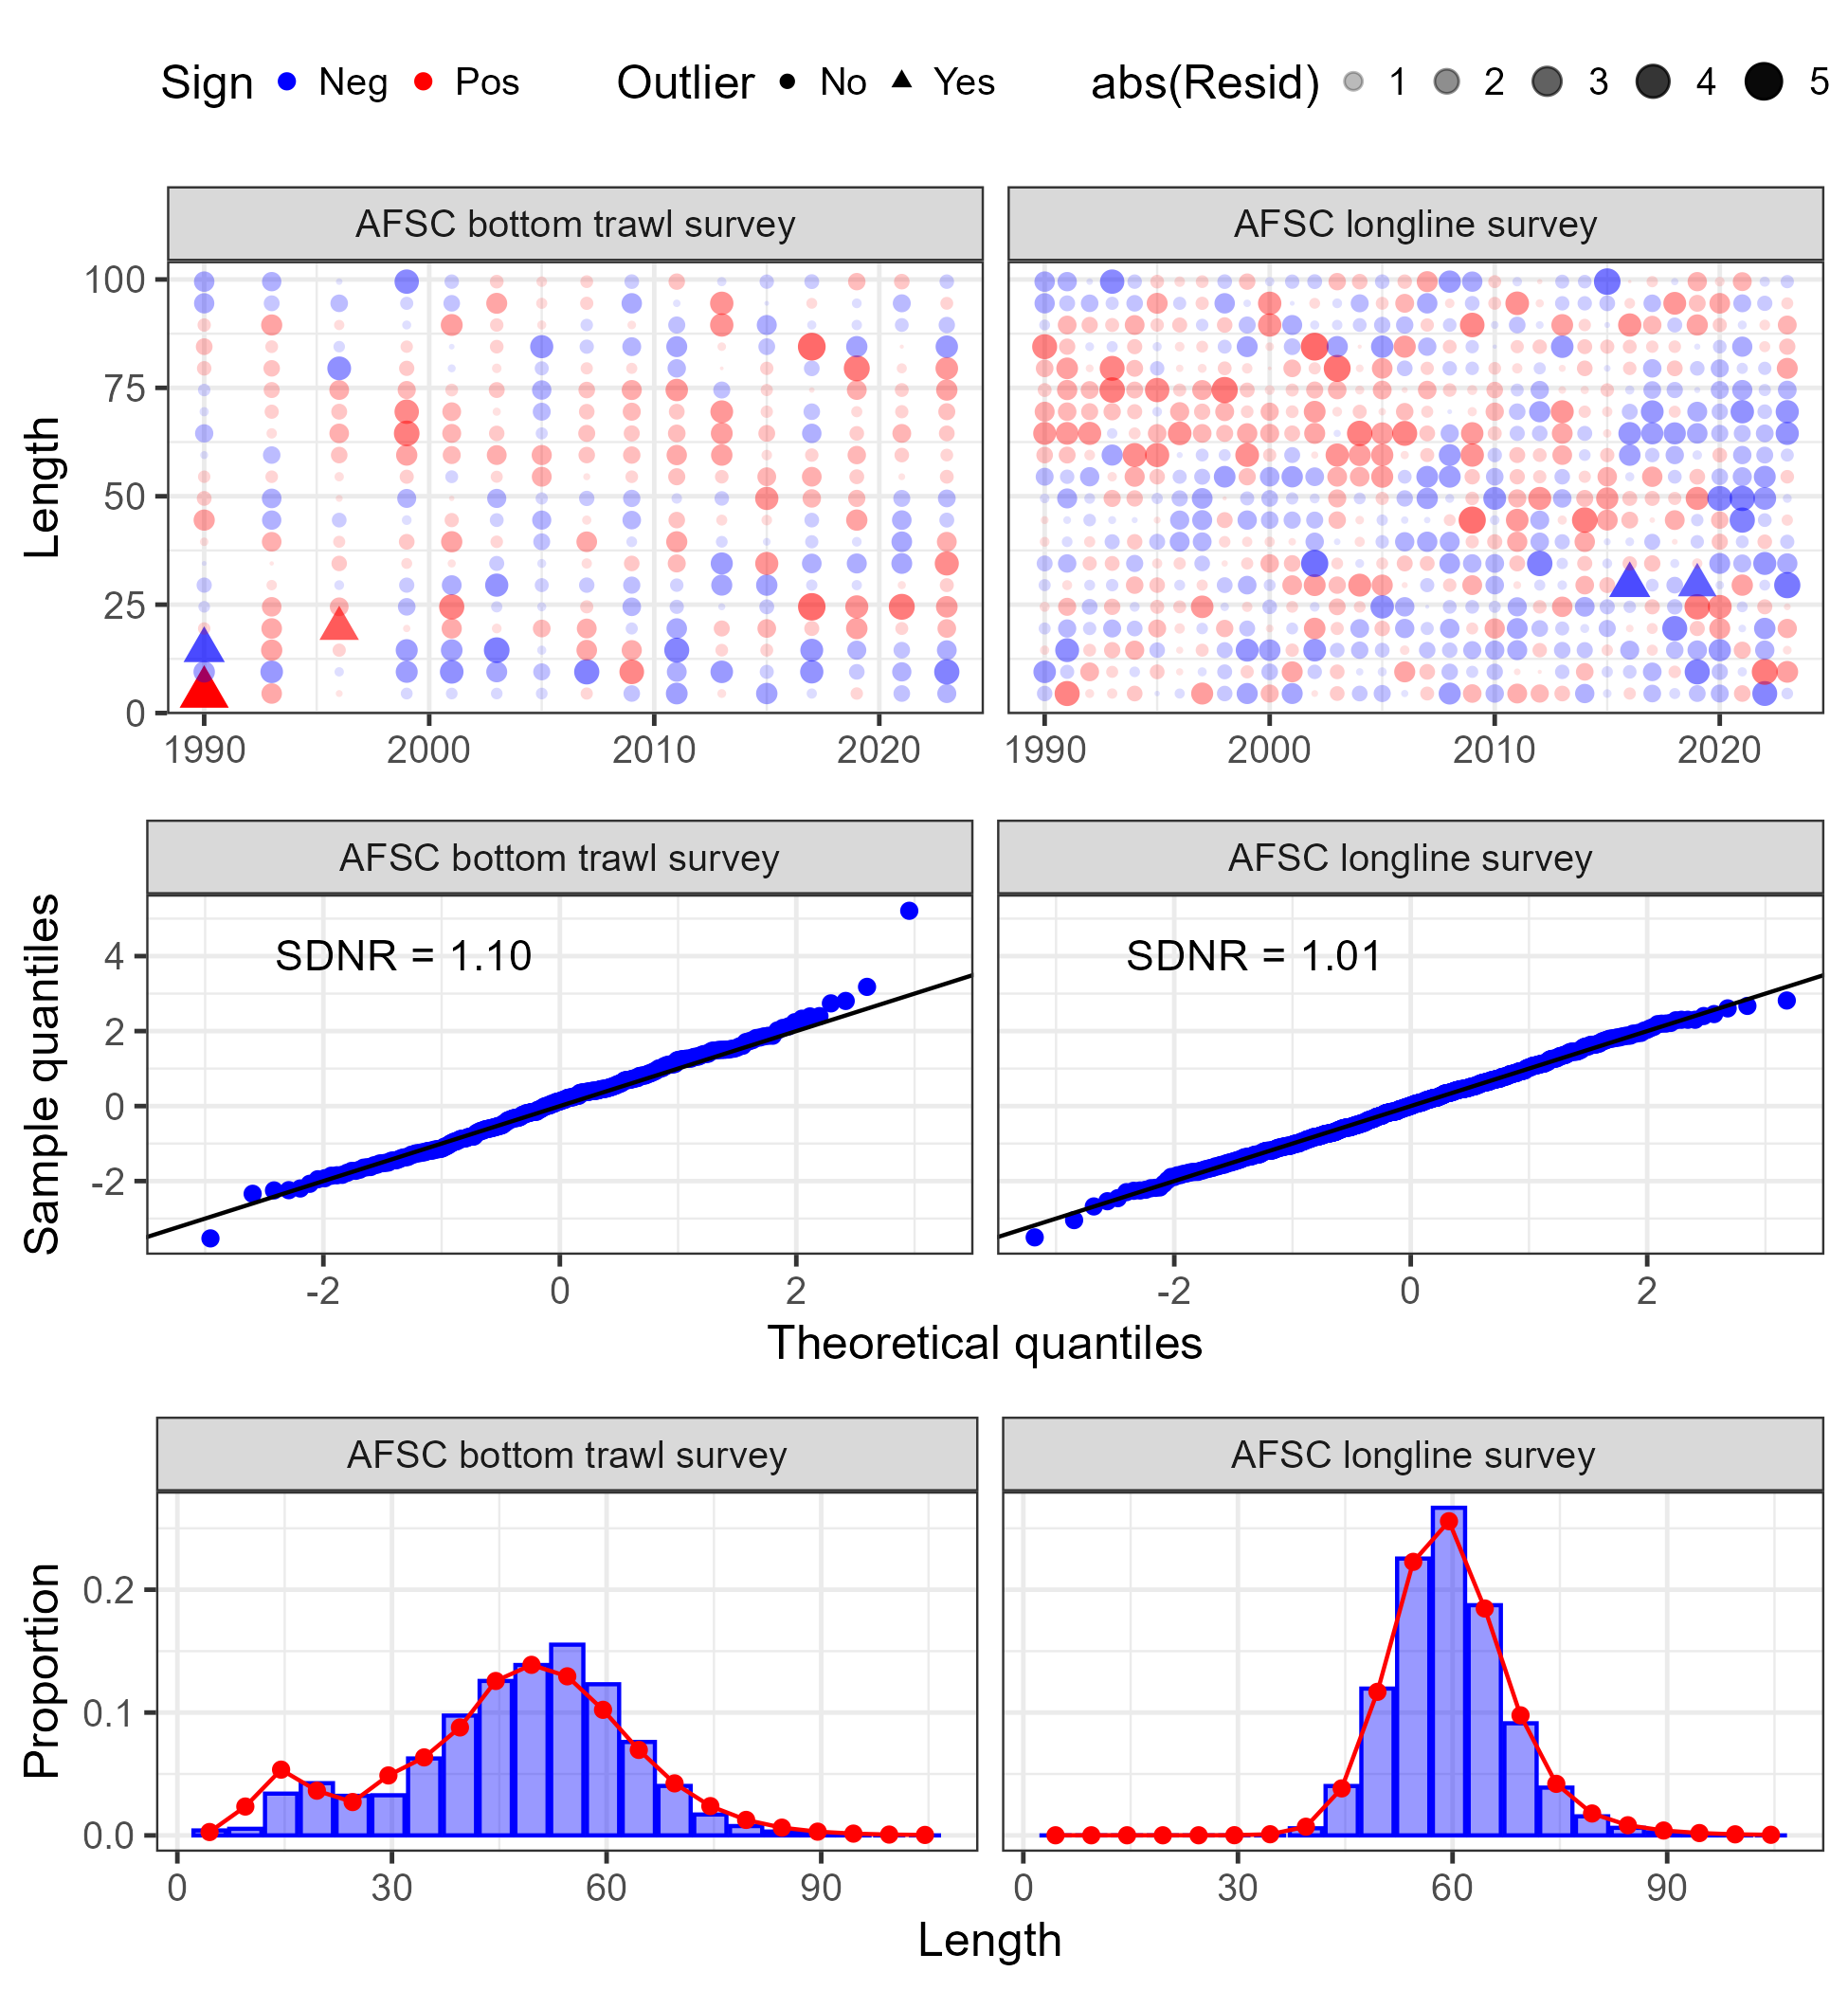
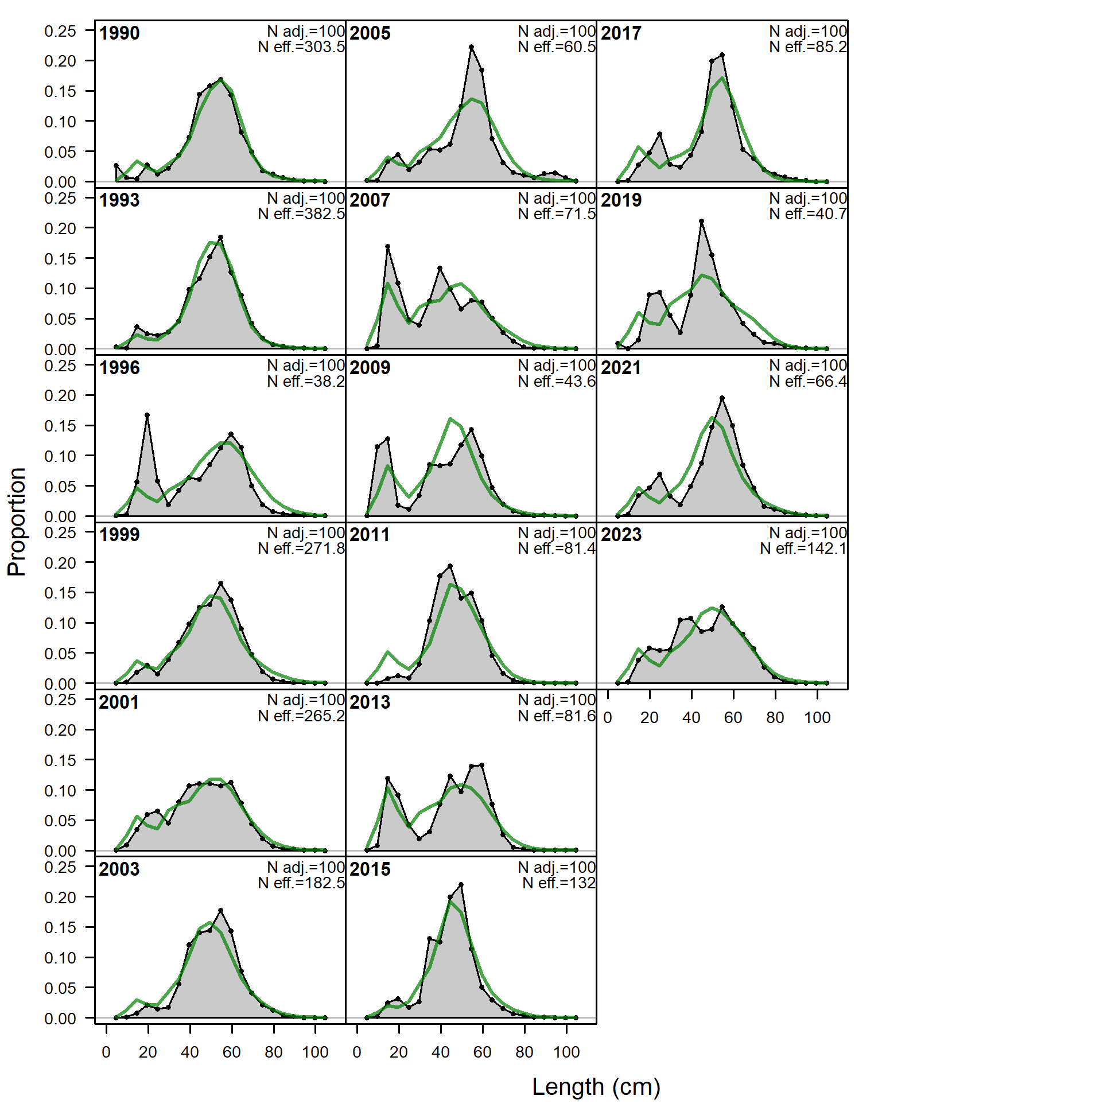
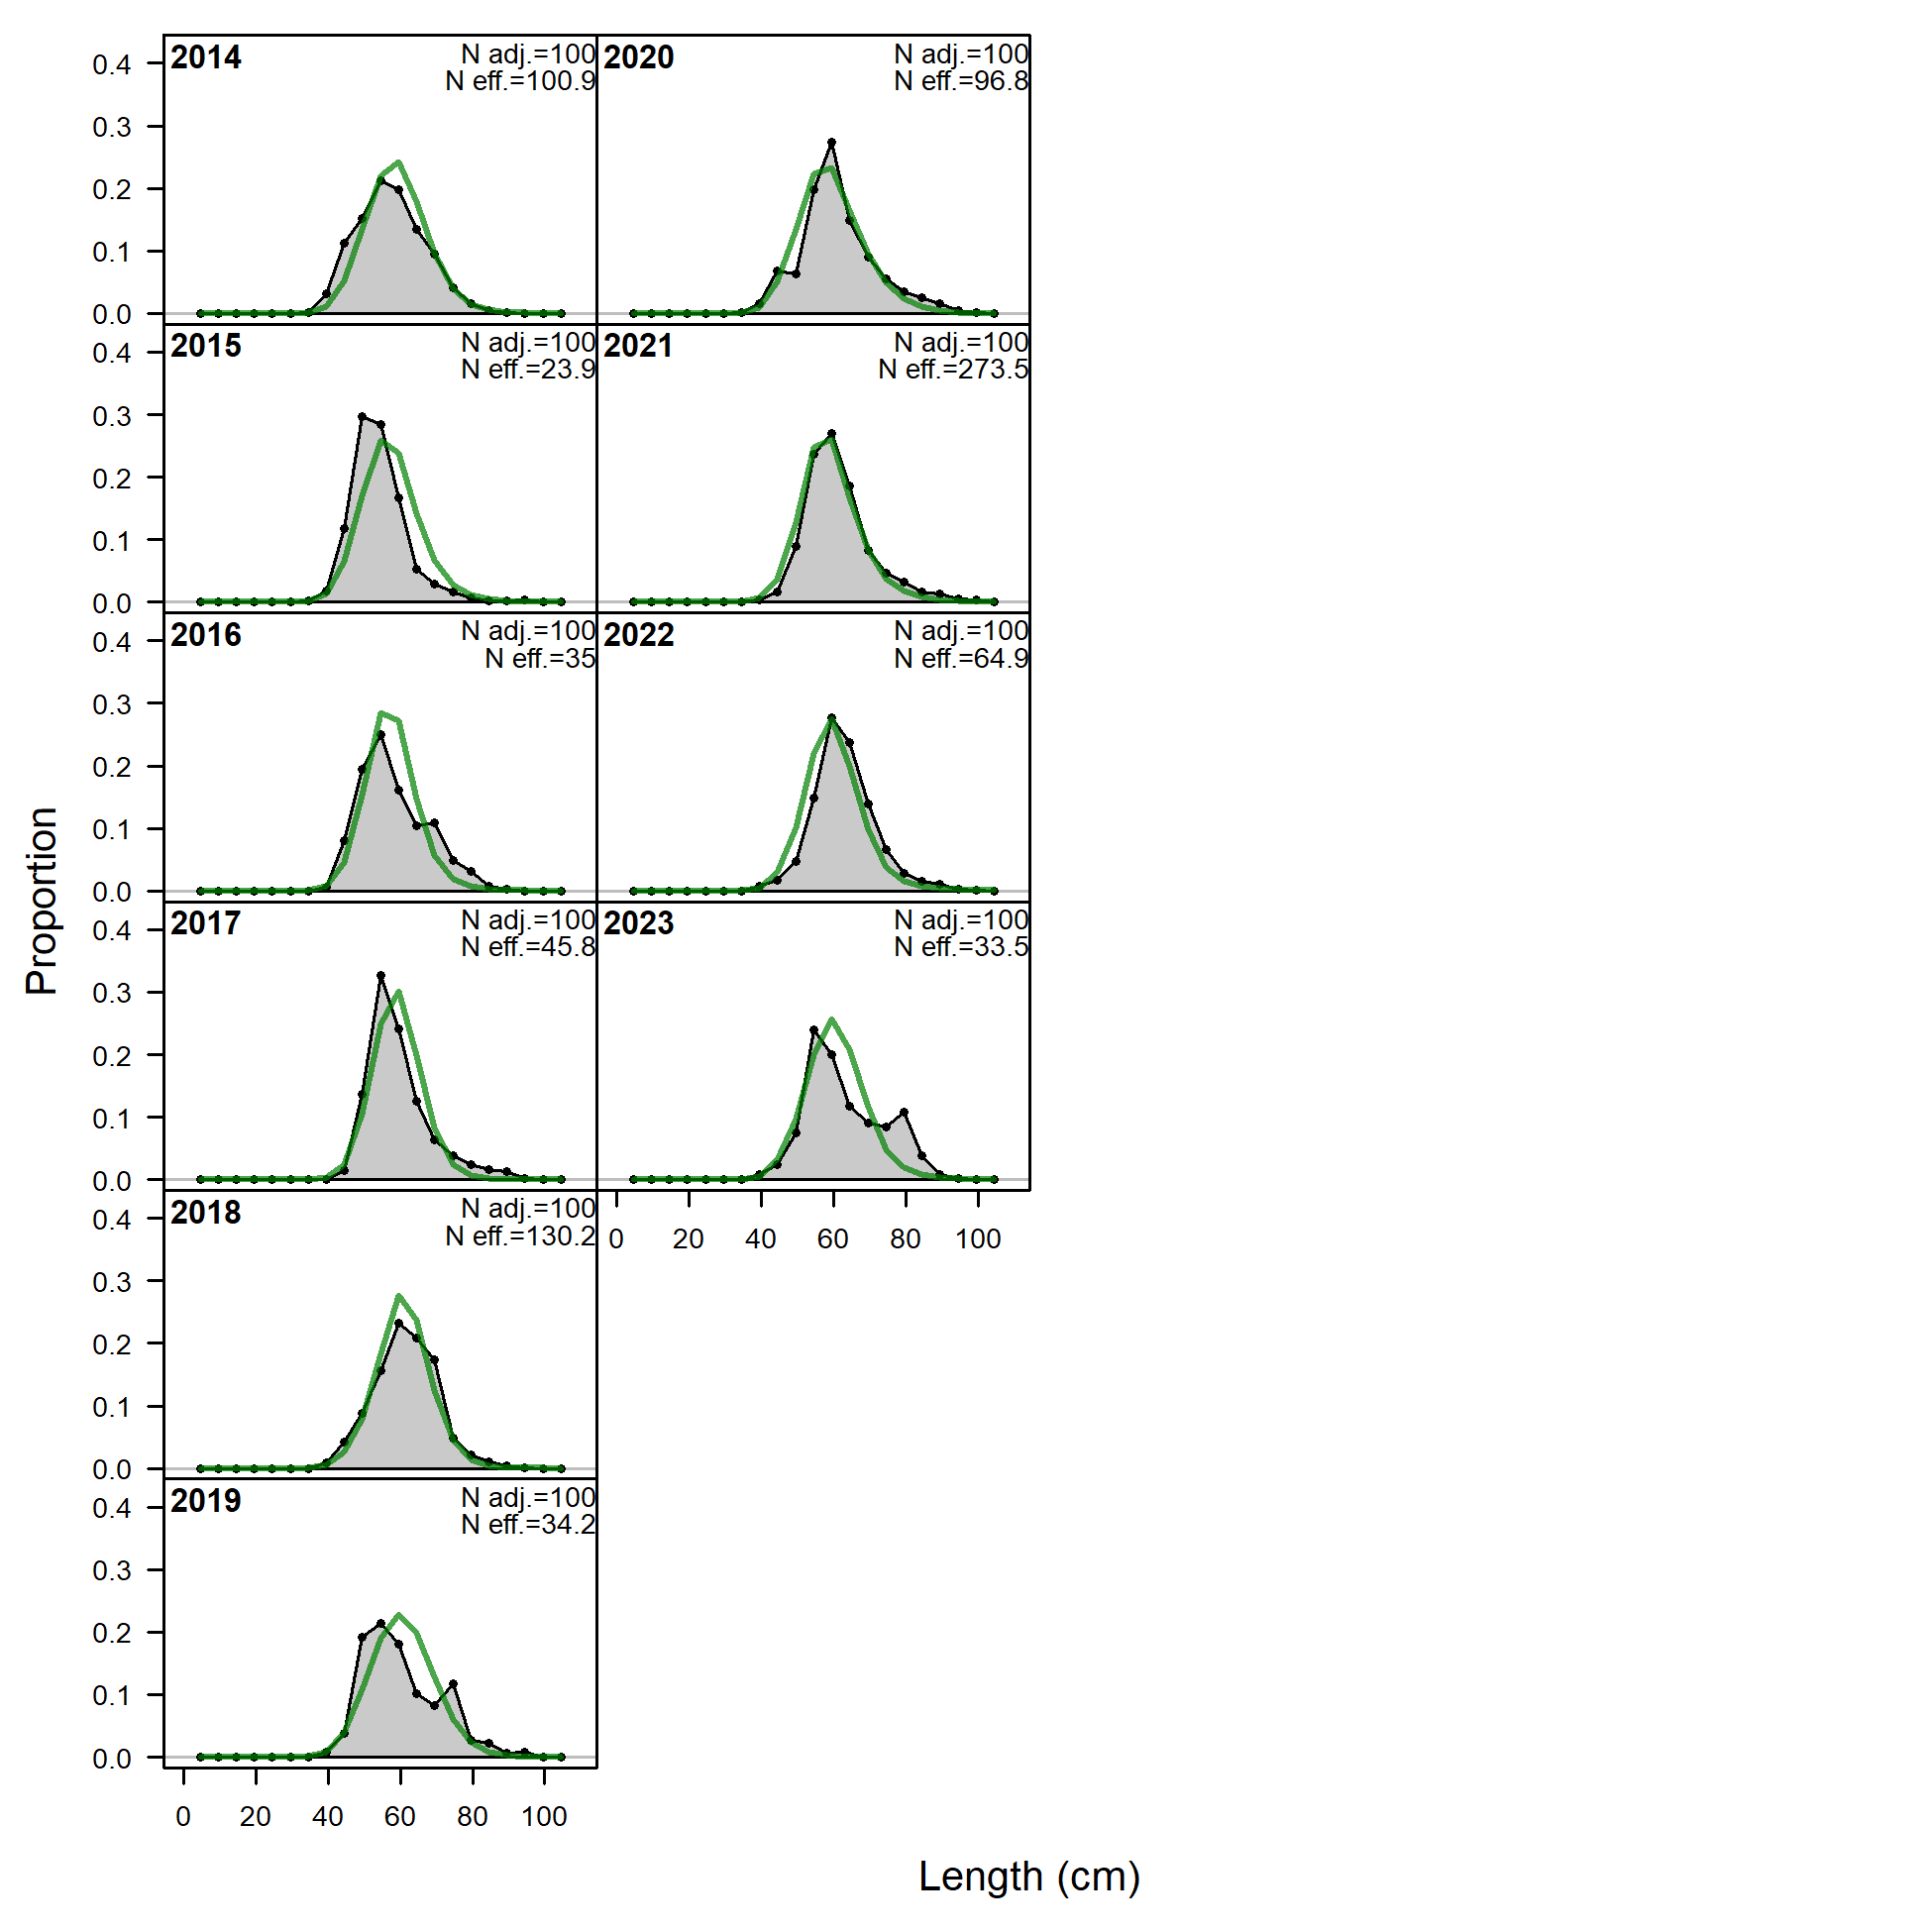
Results: data fits
No glaring sign of model misspecification in fit to survey length composition
But, some large residuals at smaller lengths in early trawl survey years and later longline survey years

Slide 30
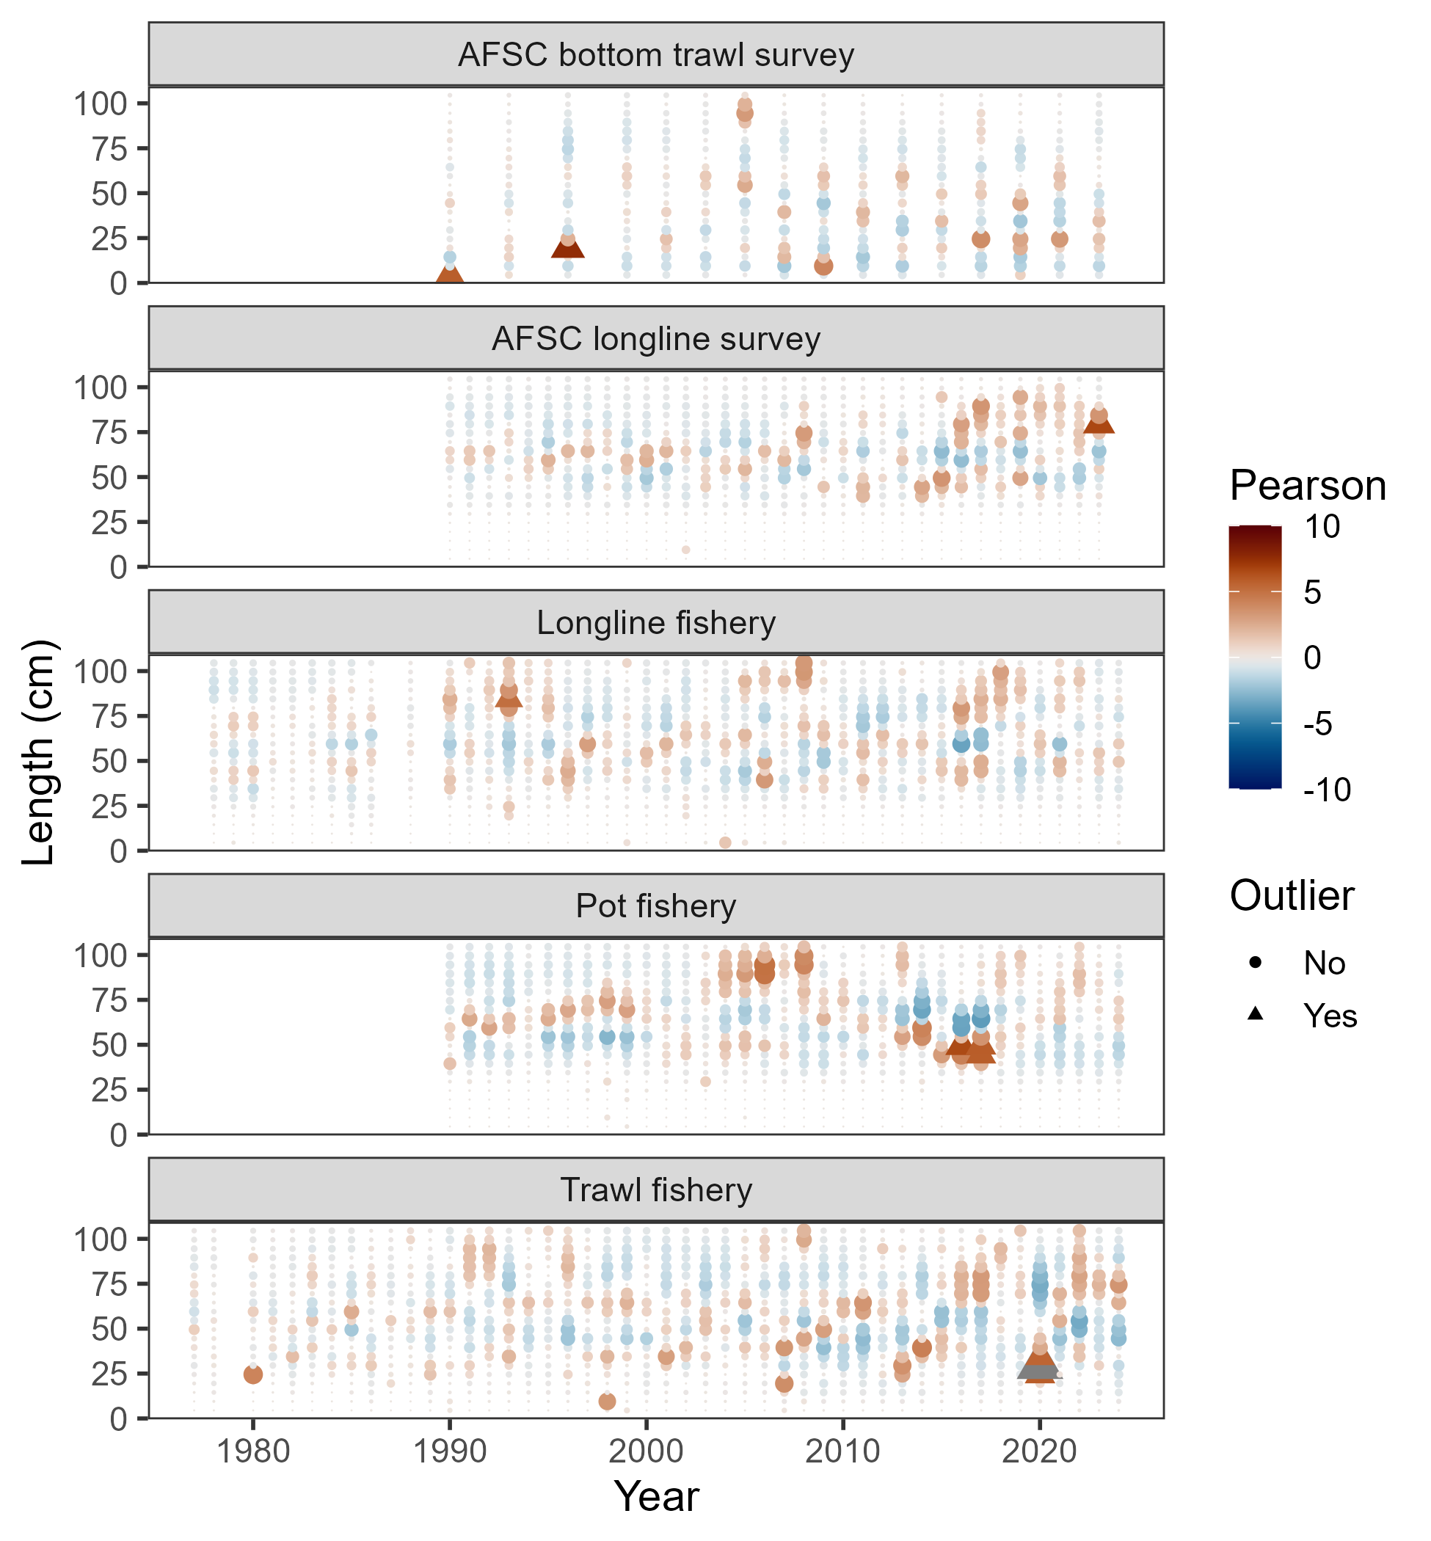
Results: data fits
Some large Pearson residuals reflected in OSA, some not

Slide 31
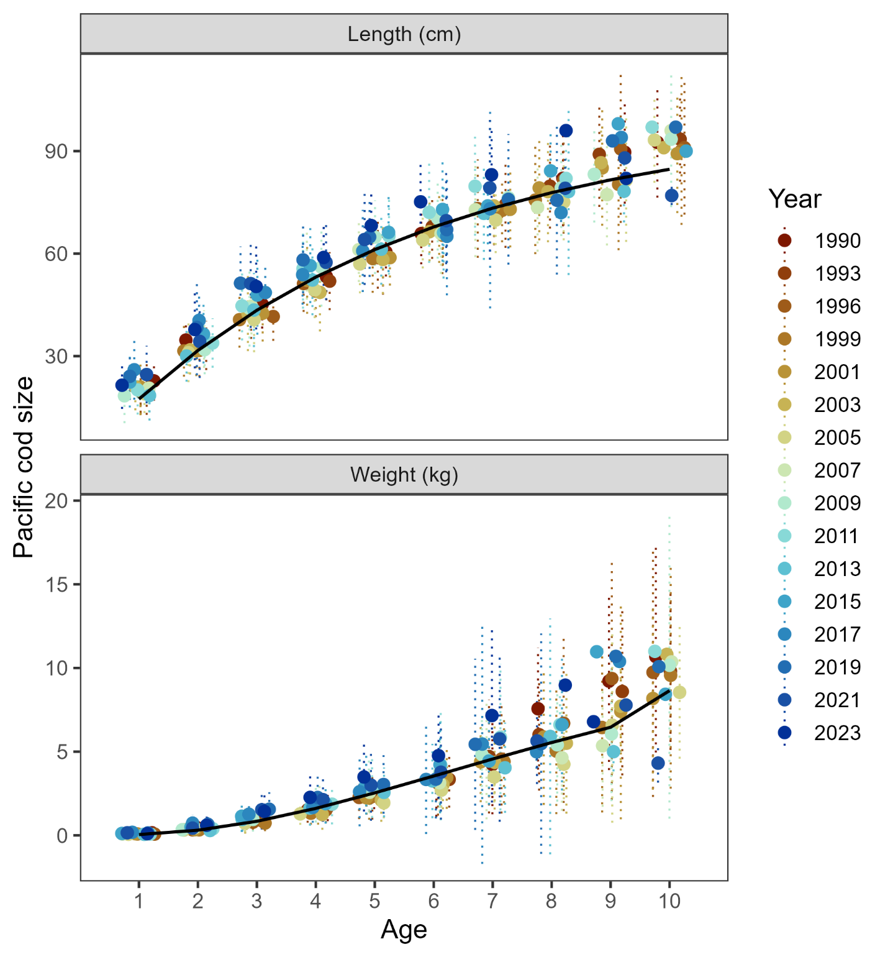
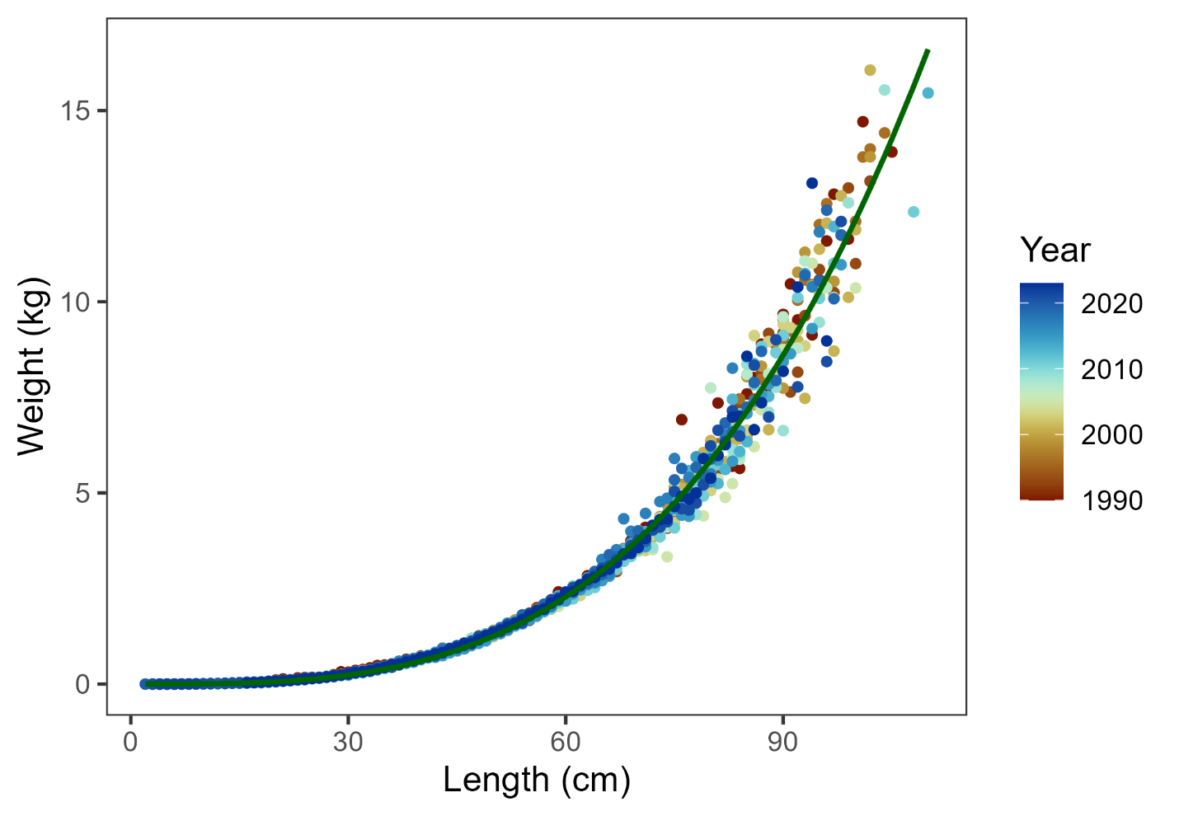
Results: data fits
Model estimates growth reasonably well, but…
Use beach seine length-weight data this year

Slide 32
Presented model diagnostics:
Retrospective: data and model
Leave-one-out: leave a year of data out
Add-one-in: add one new source of data at a time
Profile for key parameters
Other diagnostics:
Model convergence: final gradient was 6.57e⁻⁶, -no_hess ran with message “The fact this was successful gives strong evidence of convergence to a mode with quadratic log-likelihood surface.”
Jitter analysis: 50 at 5% CV, 44 converged, 78% to MLE
See in document:
MCMC: key parameter histograms, mixing, correlation
AFSC longline survey catchability sensitivity
Results: diagnostics

Slide 33
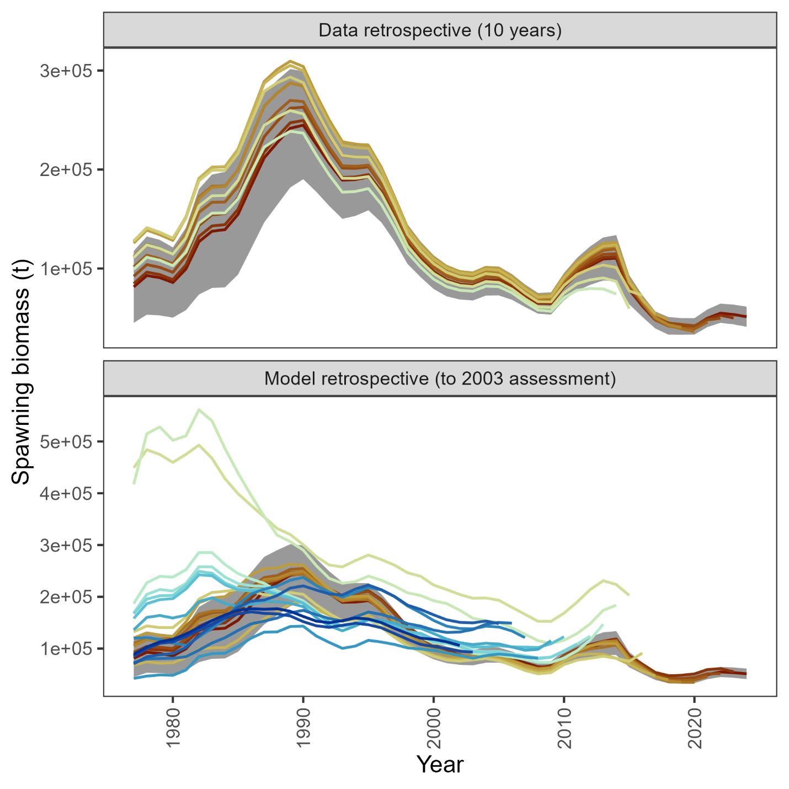
Data retrospective small & negative
Recent model retrospective consistent, but large retrospective pattern across models prior to 2015 assessment
Results: diagnostics

Slide 34
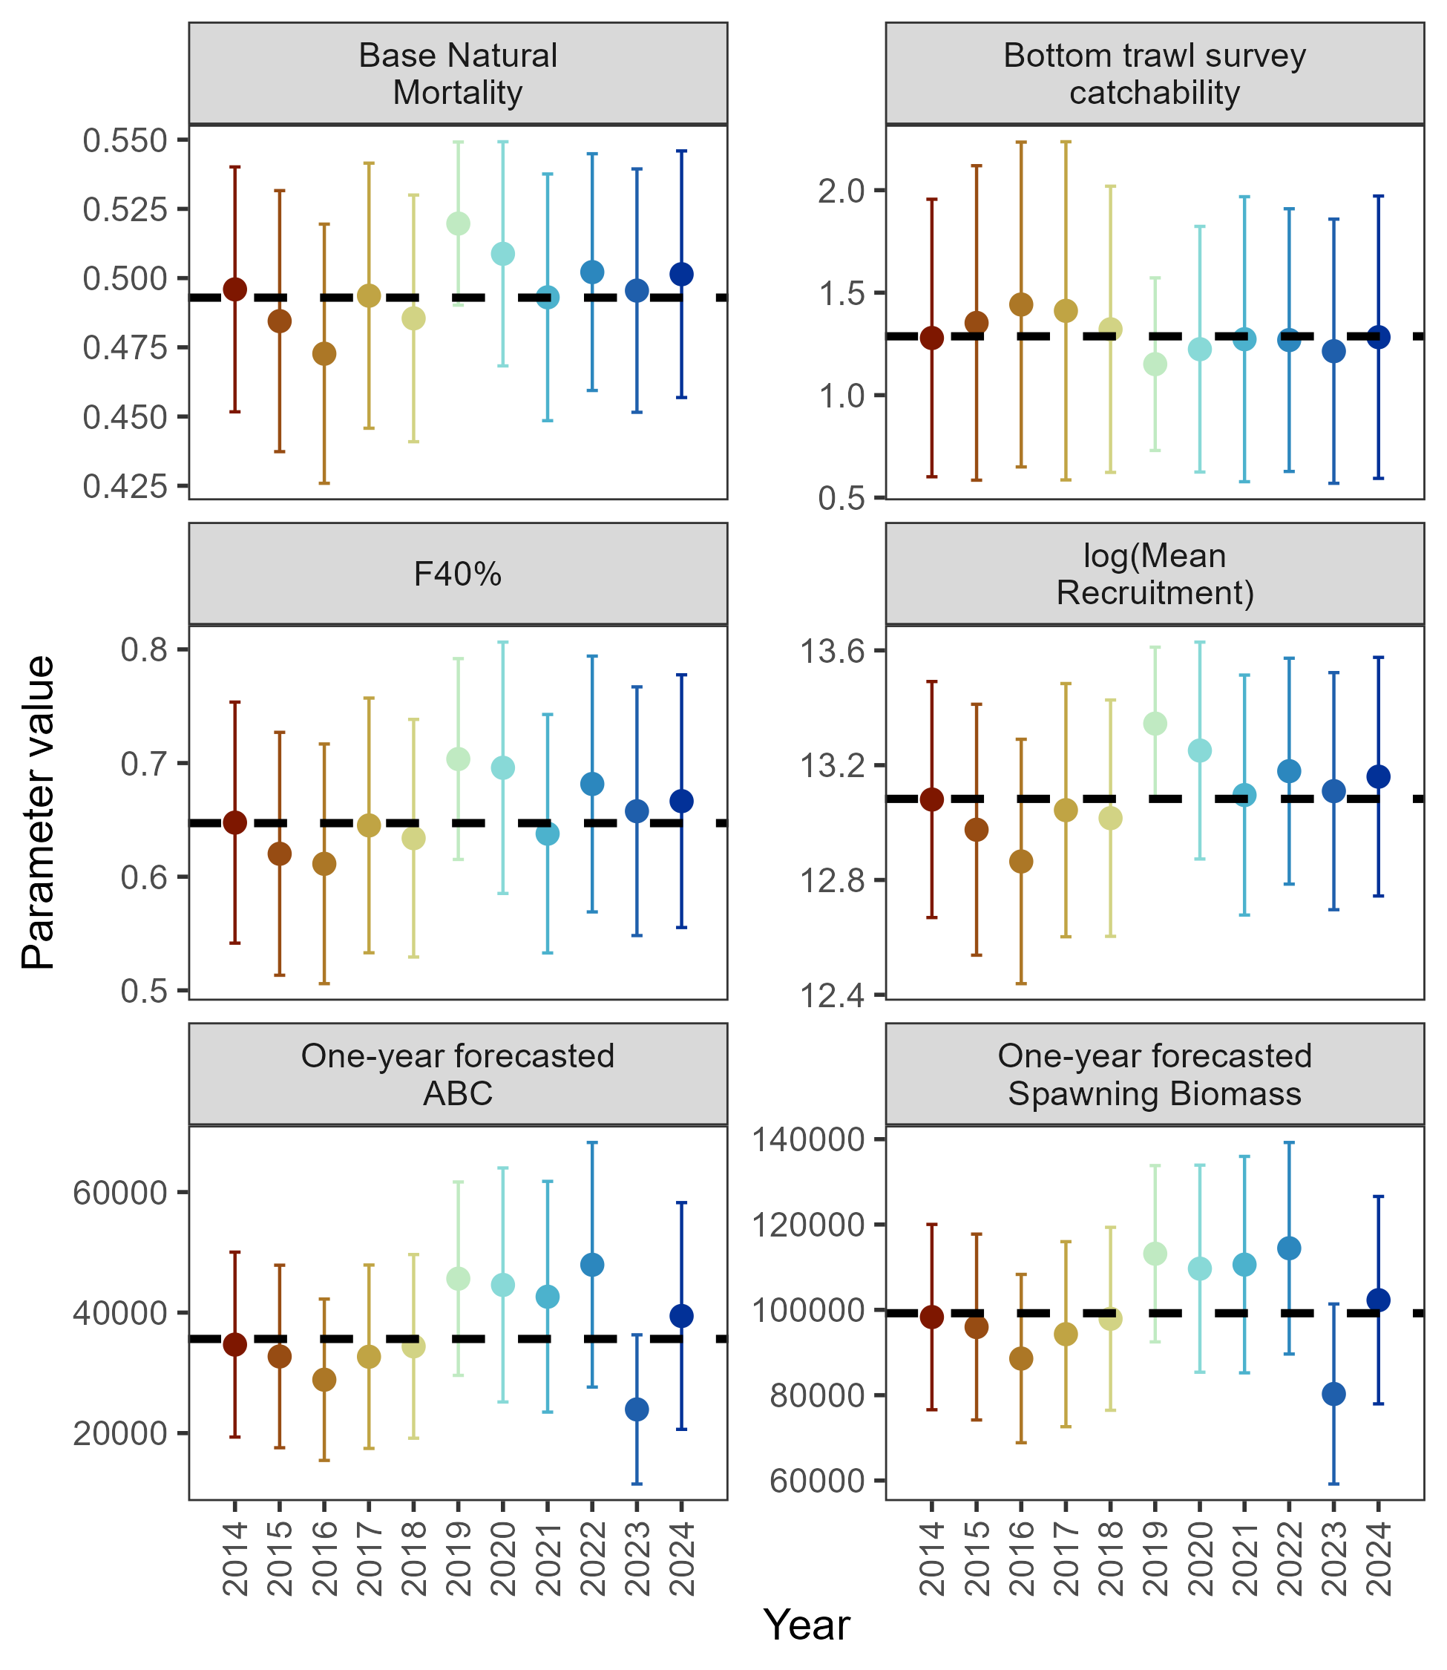
Leave-one-out: 2023 remains an influential year
Results: diagnostics

Slide 35
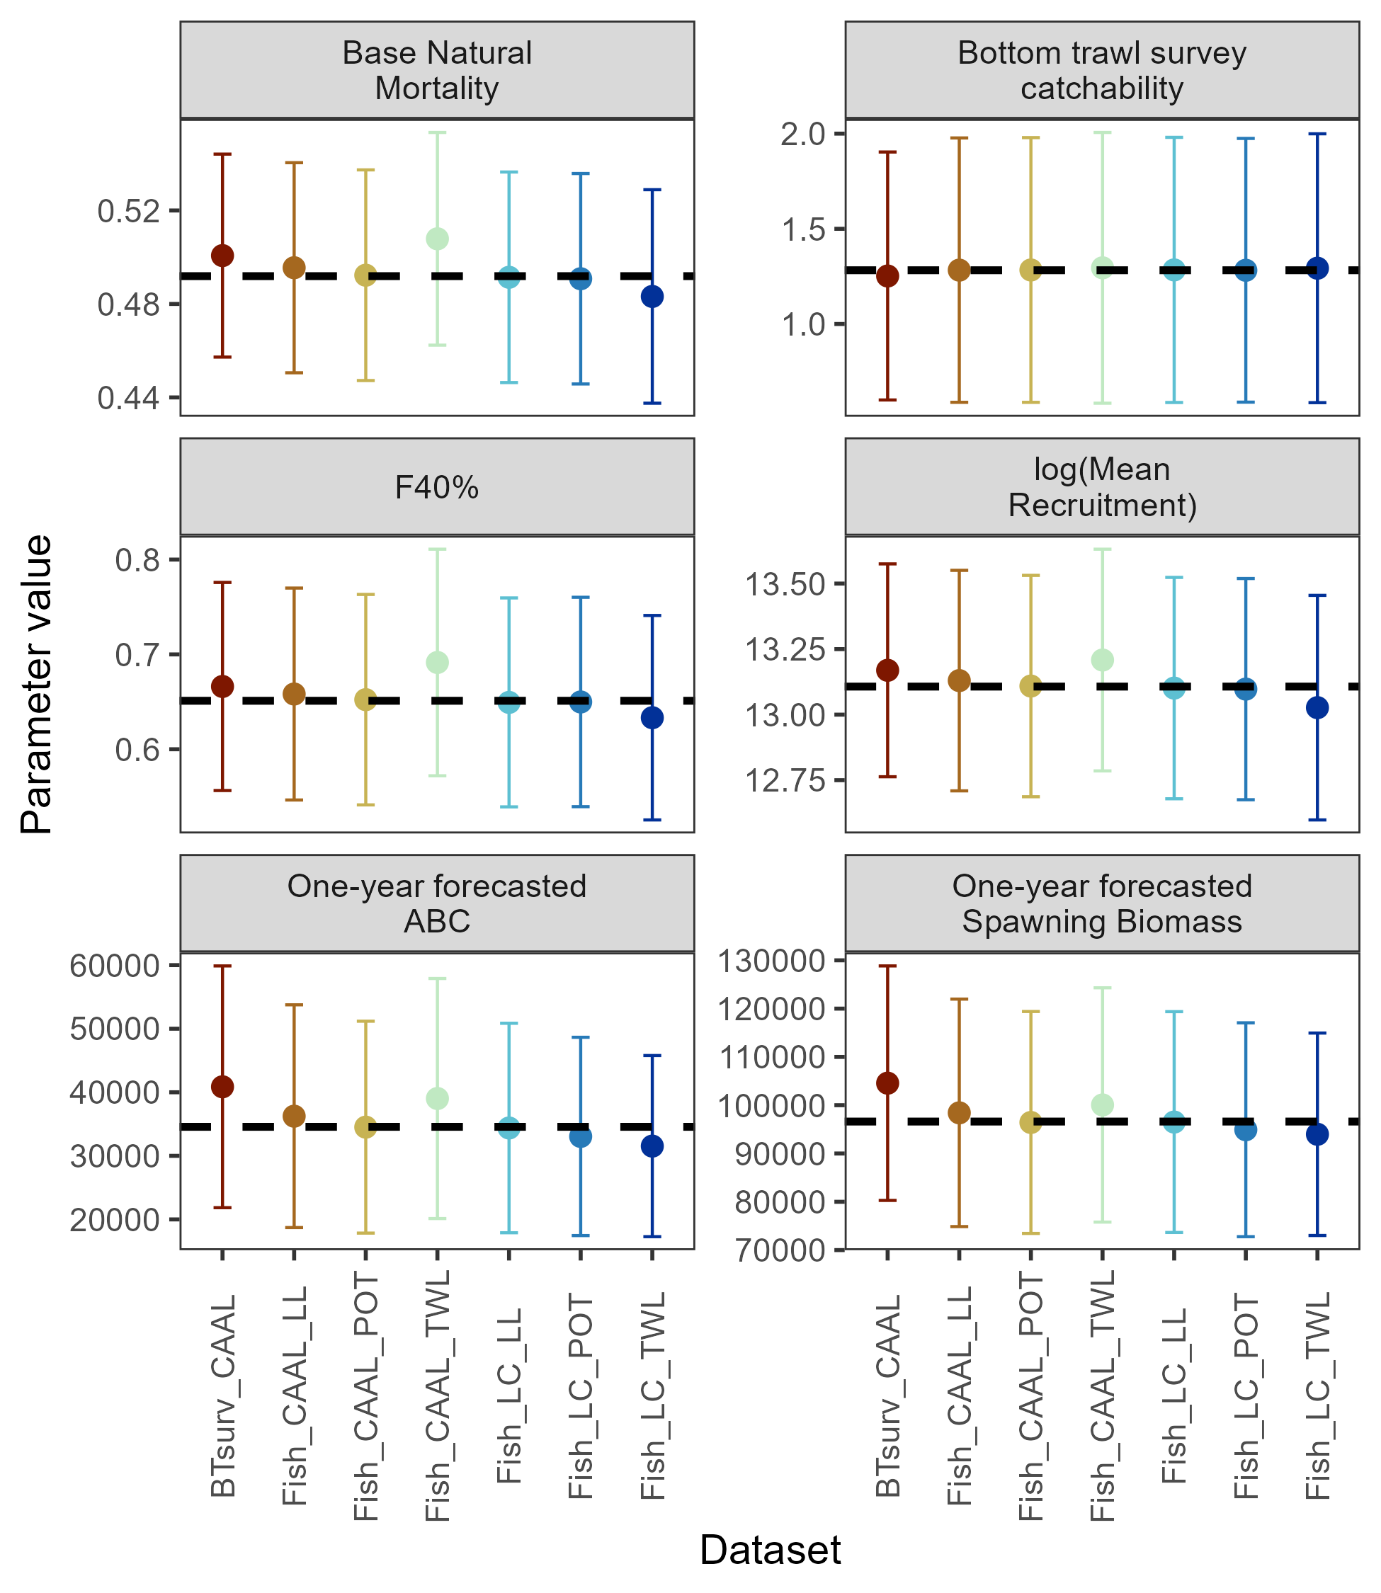
Add-one-in: 2023 AFSC bottom trawl survey and trawl fishery CAAL data influential on ABC, 2024 trawl fishery length comp to some extent
Results: diagnostics

Slide 36
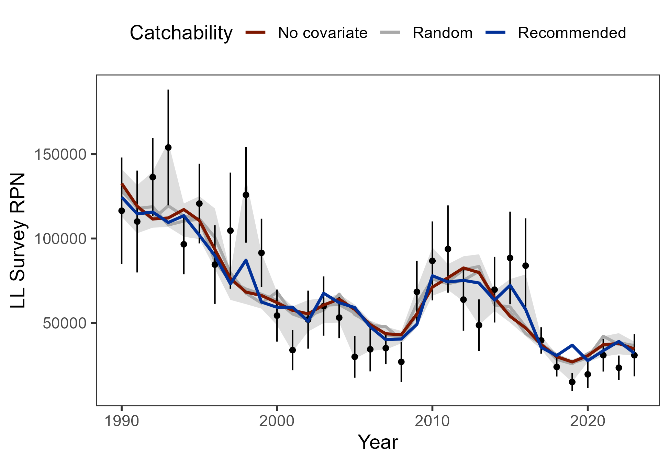
AFSC longline survey catchability sensitivity: Environmental link with CFSR remains preferred
Results: diagnostics

Slide 37
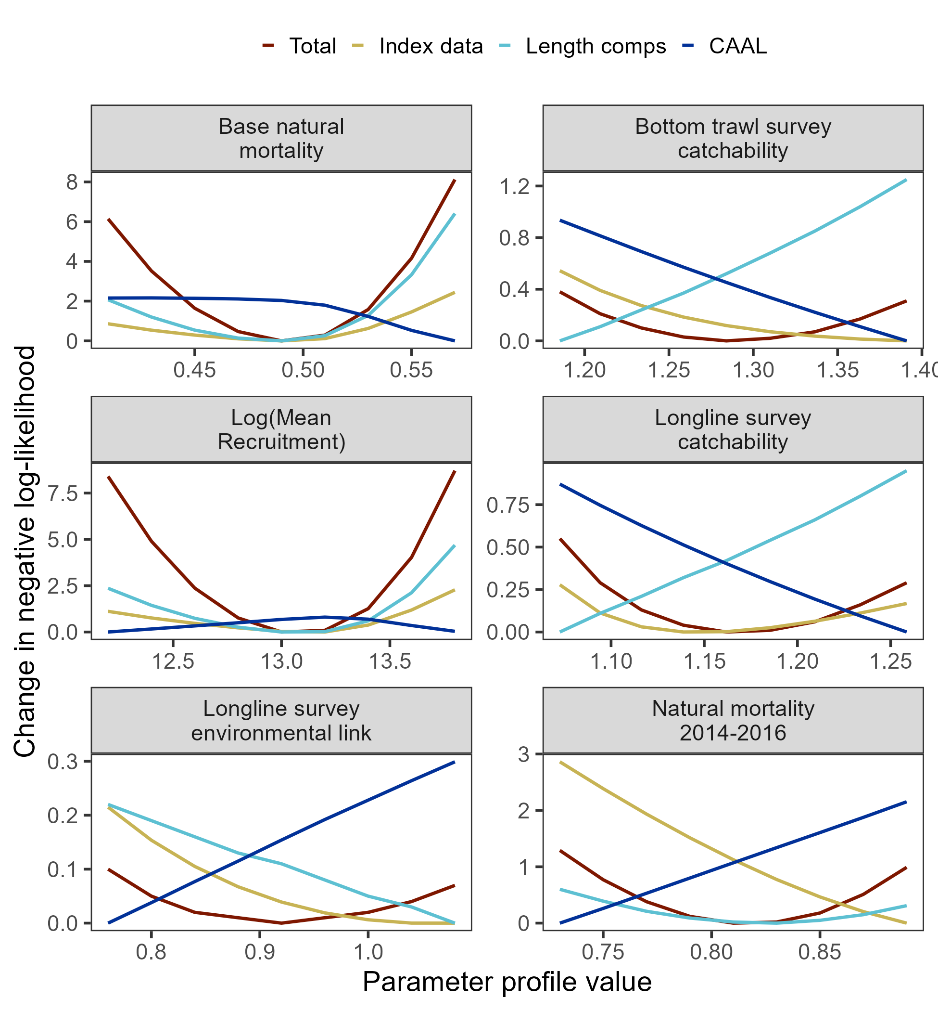
Parameter profiles:
Catchability: conflict between length comps and CAAL
Base M & lnR₀: minima confirmed by both length comps and index data
Results: diagnostics

Slide 38
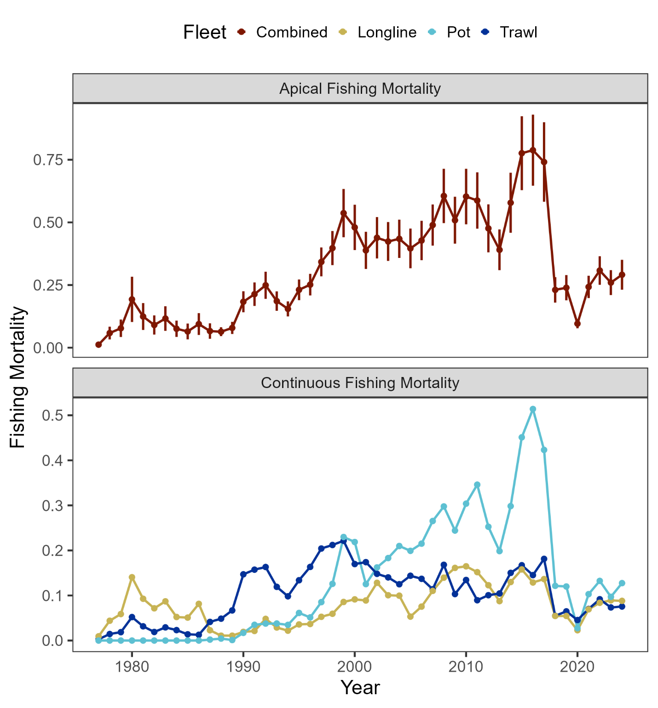
Results: parameter estimates
F staying consistent across last 4 years

Slide 39
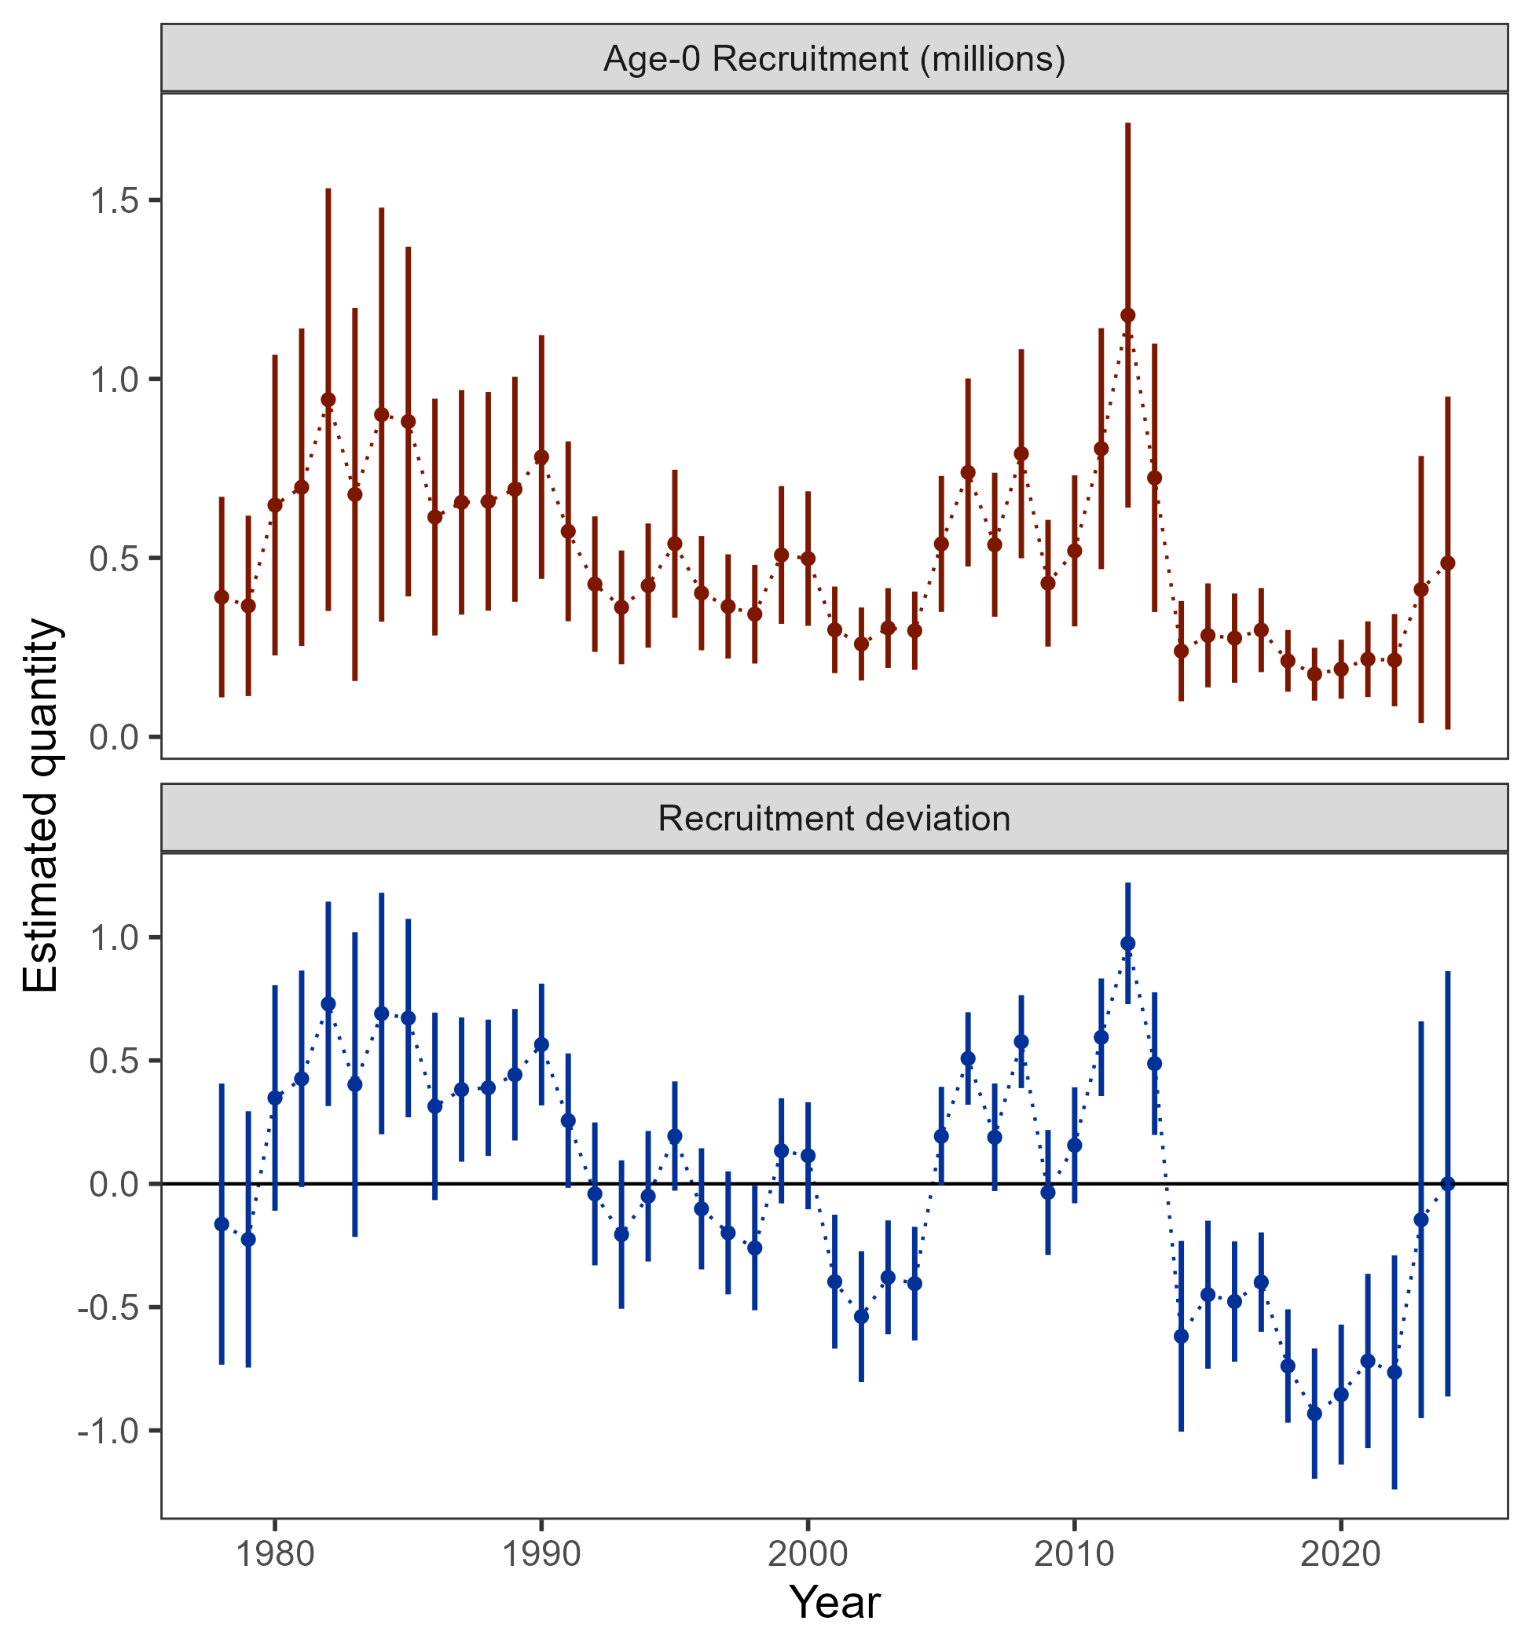
Results: parameter estimates
Below average recruitment since 2014 (following a stanza of above avg recruitment)

Slide 40
Results: parameter estimates
Name | Value | SD
Biology | -- | --
Beginning of year length at age-1 (cm) | 17.43 | 0.314
Beginning of year length at age-10 (cm) | 99.46 | 0.015
Growth rate | 0.19 | 0.002
SD in length-at-age for age-1 | 4.01 | 0.187
SD in length-at-age for age-10 | 8.99 | 0.345
Natural mortality (2014-2016) | 0.82 | 0.053
Natural mortality (all years) | 0.49 | 0.023
Recruitment/Abundance | -- | --
log(mean recruitment) | 13.09 | 0.213
1976 Regime adjustment | -0.68 | 0.19
Survey catchability | -- | --
Bottom trawl survey | 1.28 | 0.125
Longline survey | 1.16 | 0.108
Longline survey environmental coefficient | 0.94 | 0.411

Slide 41
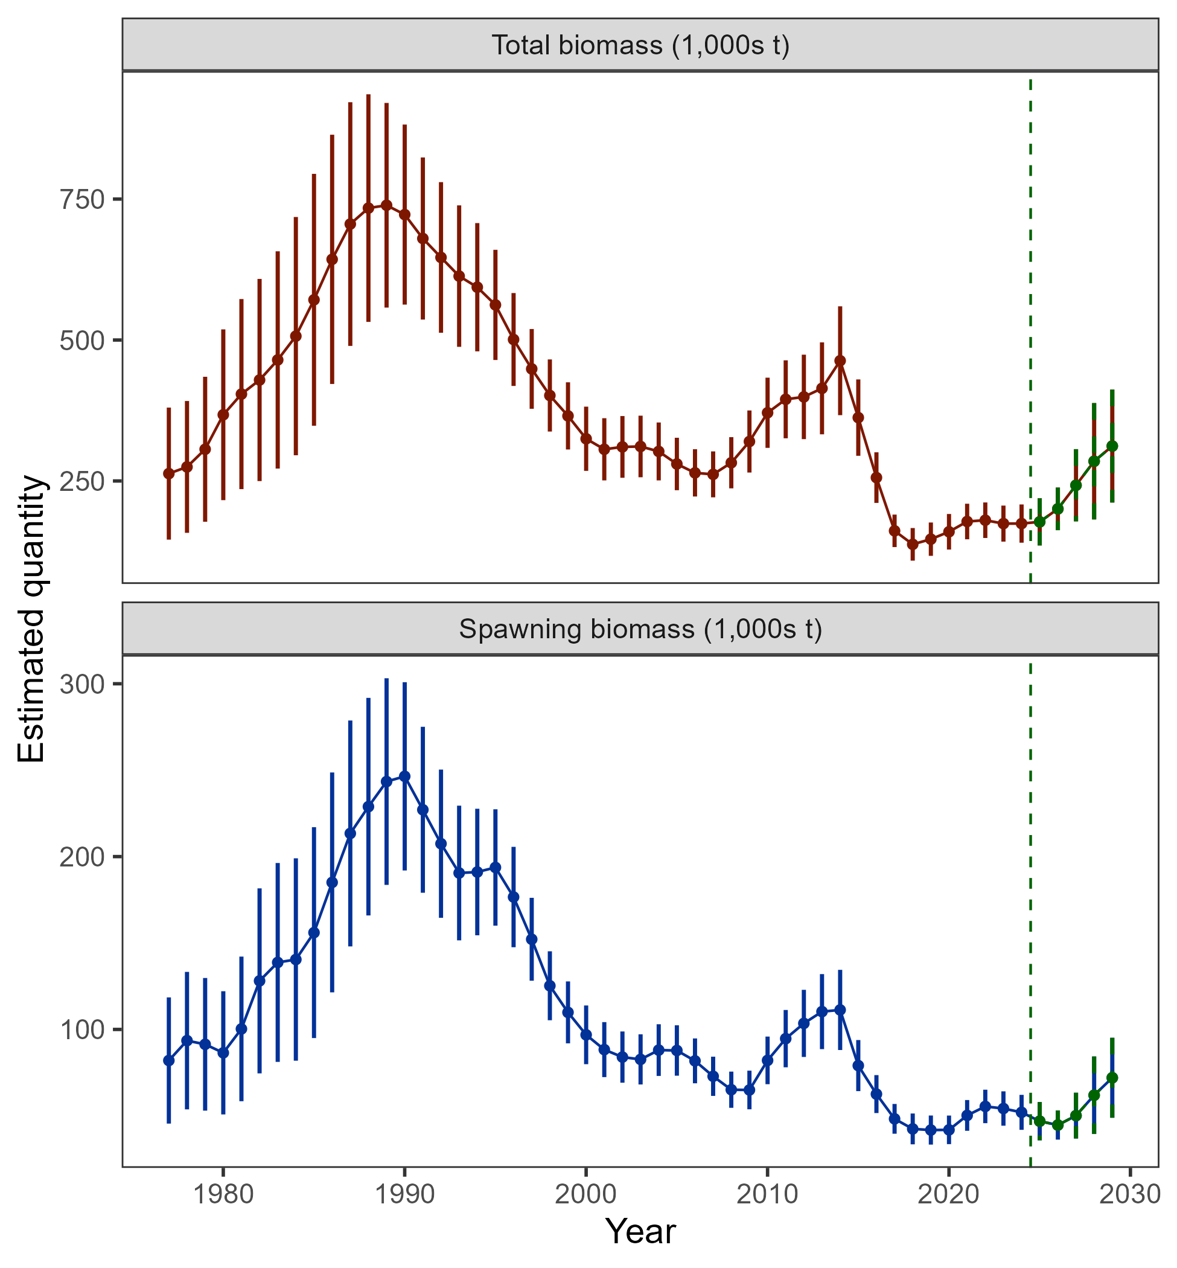
Results: time series
Biomass projected to increase, but, based on realization of average recruitment

Slide 42
Stock status
Risk table
ABC/OFL recommendations
Apportionment
Results: recommendations

Slide 43

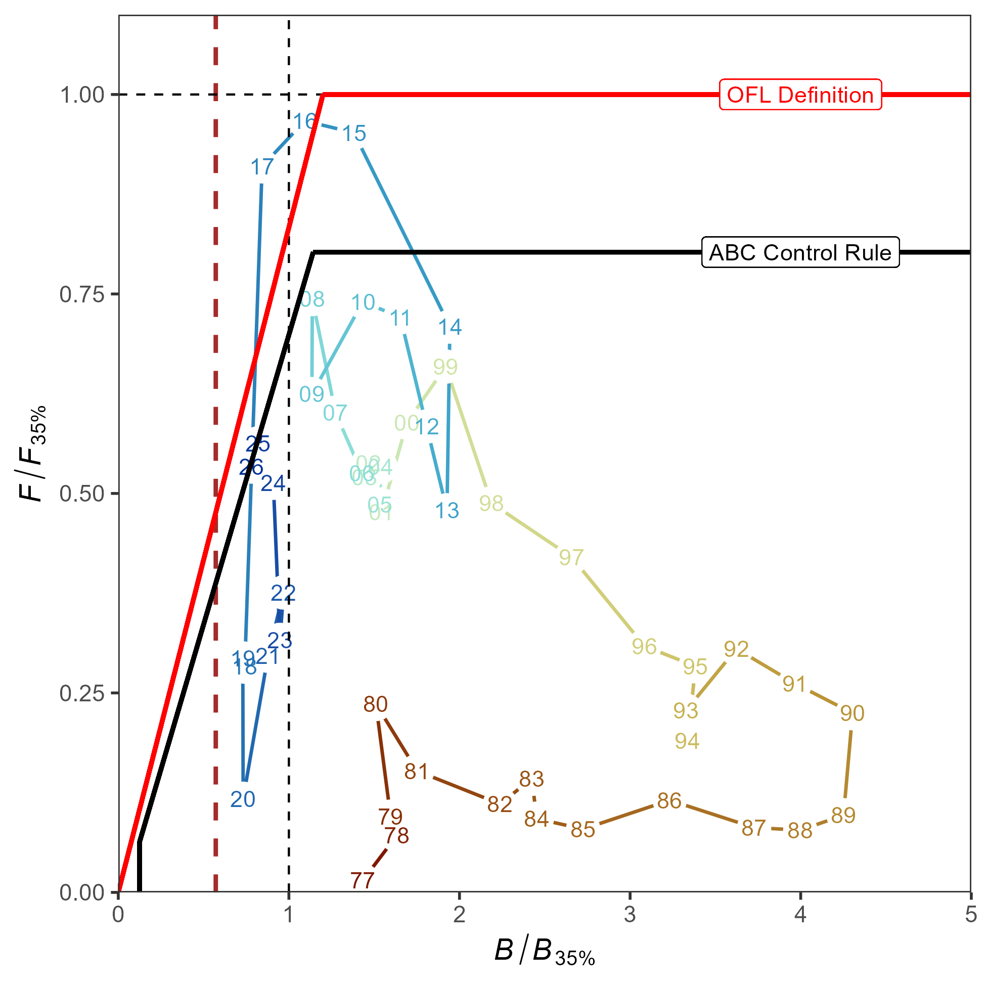
Stock status
Tier 3b: on the ramp
Estimated to be above B_{20%} (dashed red line), 2025 = B_{28.7%}

Slide 44
Risk table
Assessment considerations: Level 1
Pop dy considerations: Level 2 – will remain while population at low levels with added uncertainty as to how processes will respond to future environmental conditions (i.e., recruitment)
Environmental/ecosystem considerations: Level 1
Fishery performance: Level 1

Slide 45
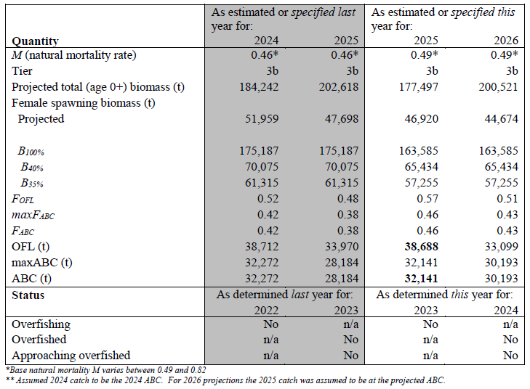
ABC/OFL recommendations
Recommend Model 24.0: <1% different than 2024 ABC

Slide 46
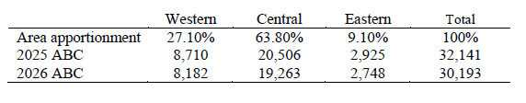
apportionment
Same as 2023, but with updated ABC

Slide 47
Current and Future work
Current research:
Krista Oke: env links
OSU: spatial model for WGOA/EBS
Assessment to do:
Look at 2 index REMA model for apportionment
Bin structure
Input sample size for comp data
Look at what data used for conditional age-at-length
Start looking at TMB
Growth evaluations
Something else to consider:
Maturity information

Slide 48
Questions?

Slide 49
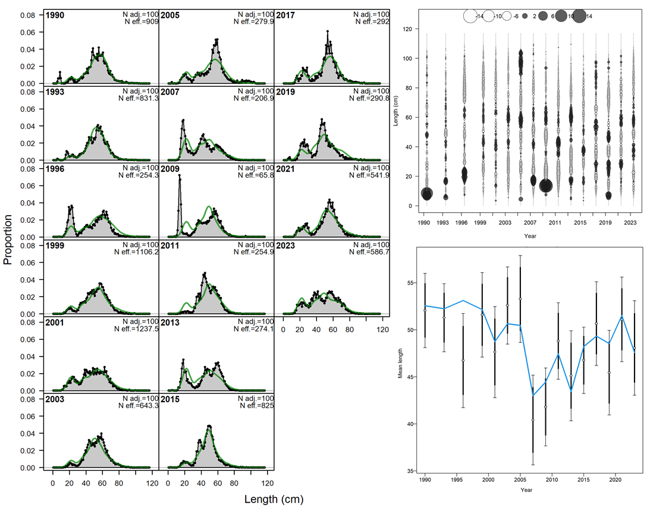
AFSC bottom trawl survey length comps

Slide 50
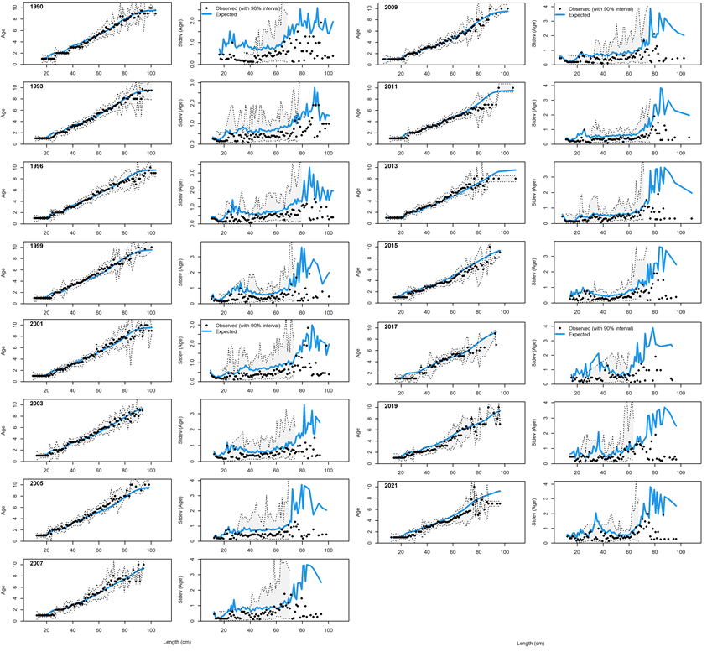
AFSC bottom trawl survey conditional age-at-length

Slide 51
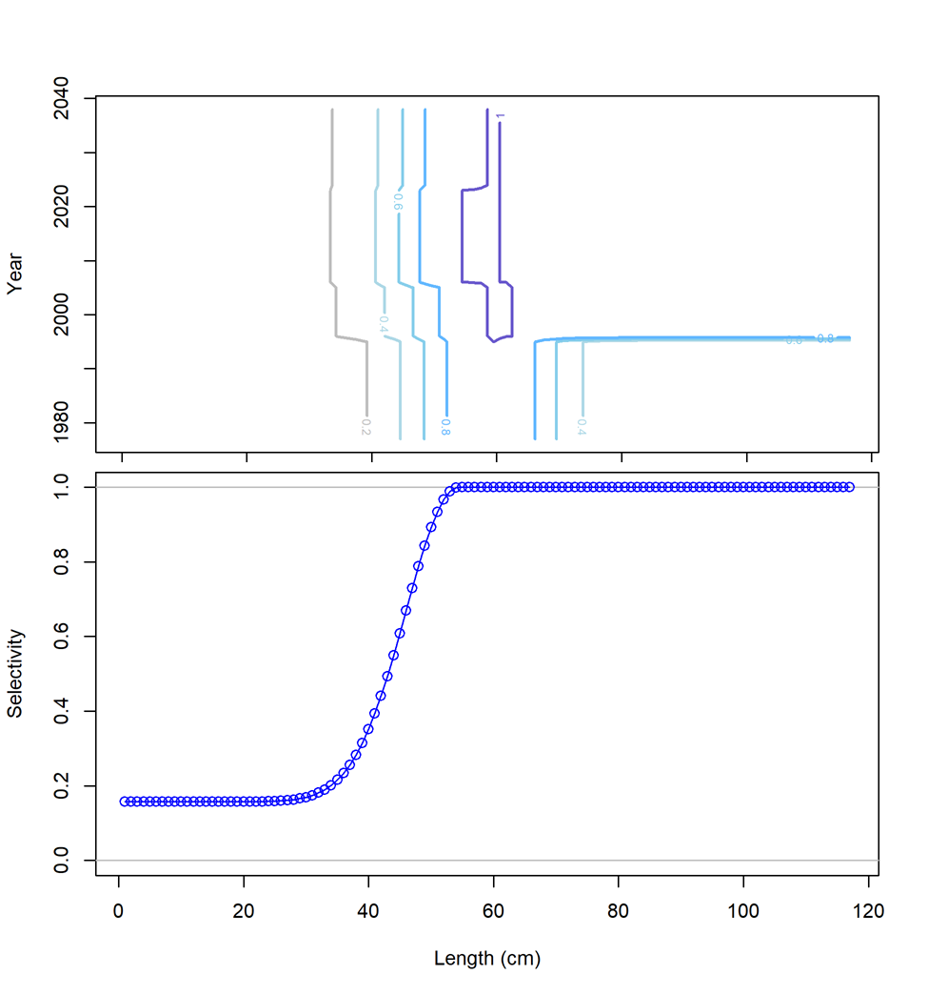
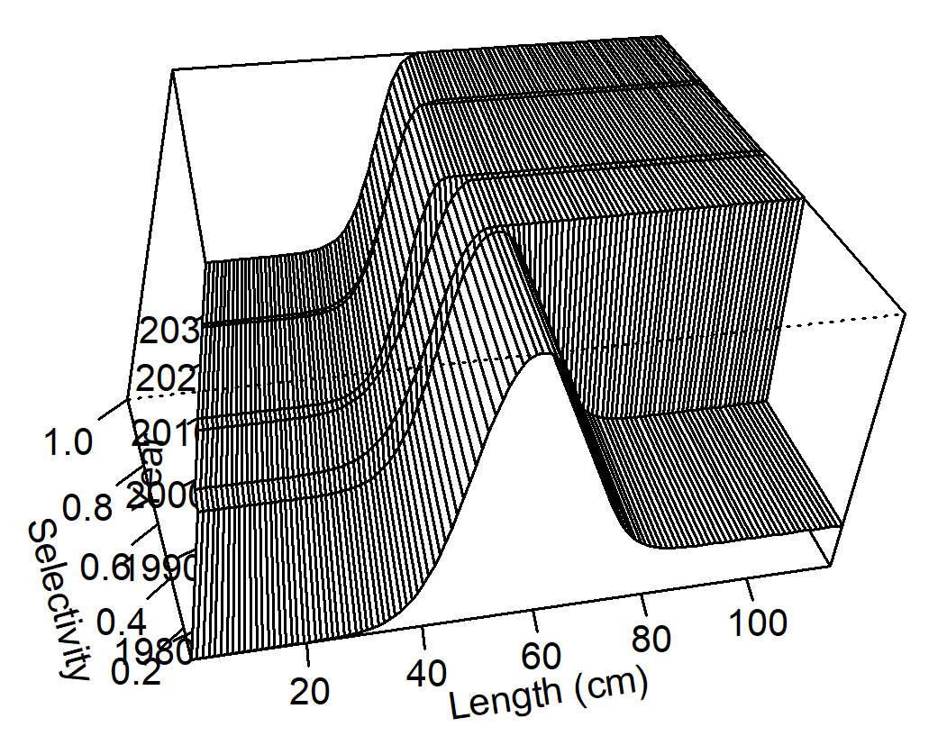
AFSC bottom trawl survey selectivity

Slide 52
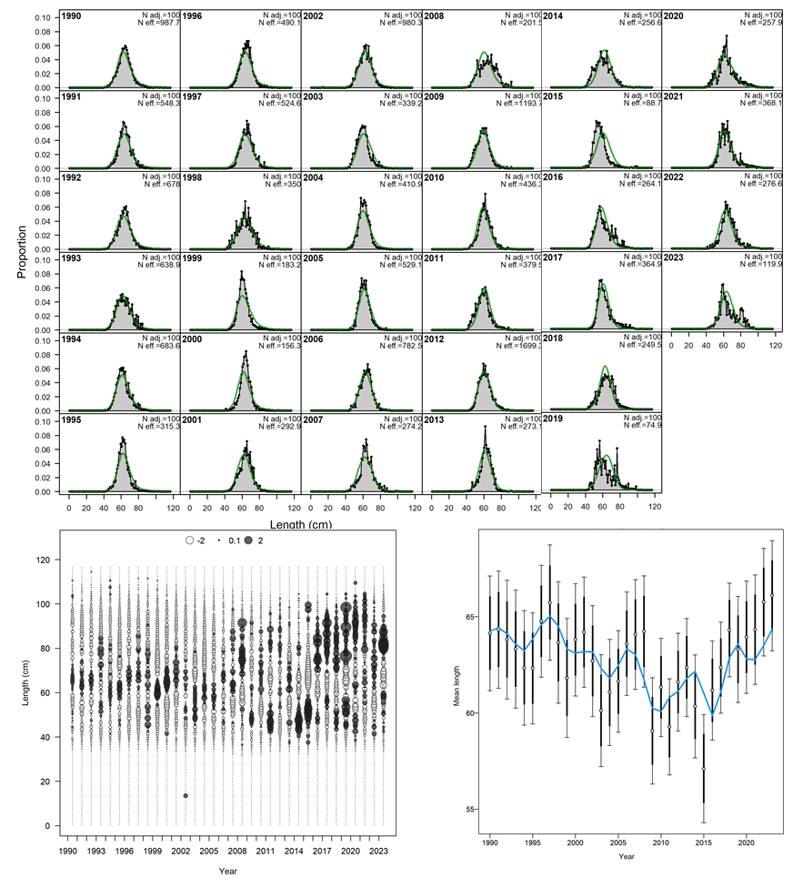
AFSC longline survey length comps

Slide 53
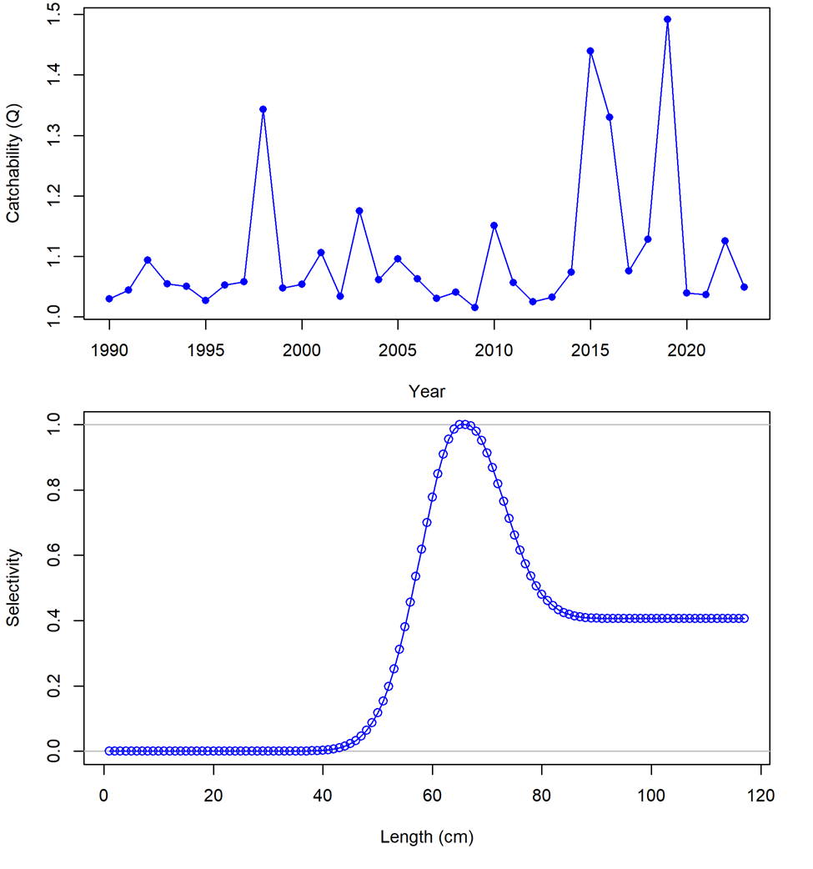
AFSC longline survey catchability and selectivity

Slide 54
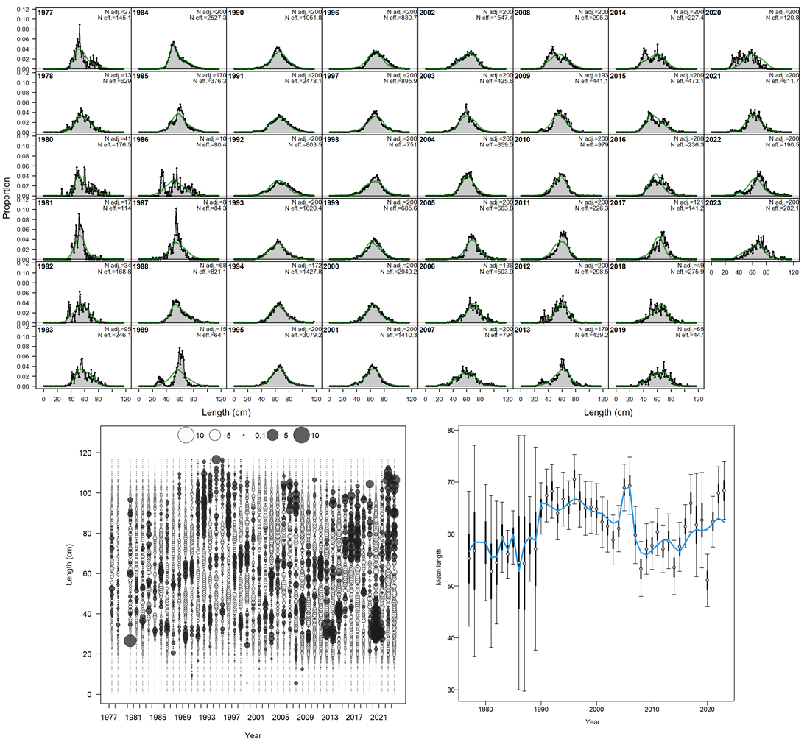
Trawl fishery length comps

Slide 55

Trawl fishery conditional age-at-length

Slide 56


Trawl fishery selectivity

Slide 57

Longline fishery length comps

Slide 58

Longline fishery conditional age-at-length

Slide 59


Longline fishery selectivity

Slide 60

Pot fishery length comps

Slide 61

Pot fishery condition age-at-length

Slide 62


Pot fishery selectivity

